Slide 1
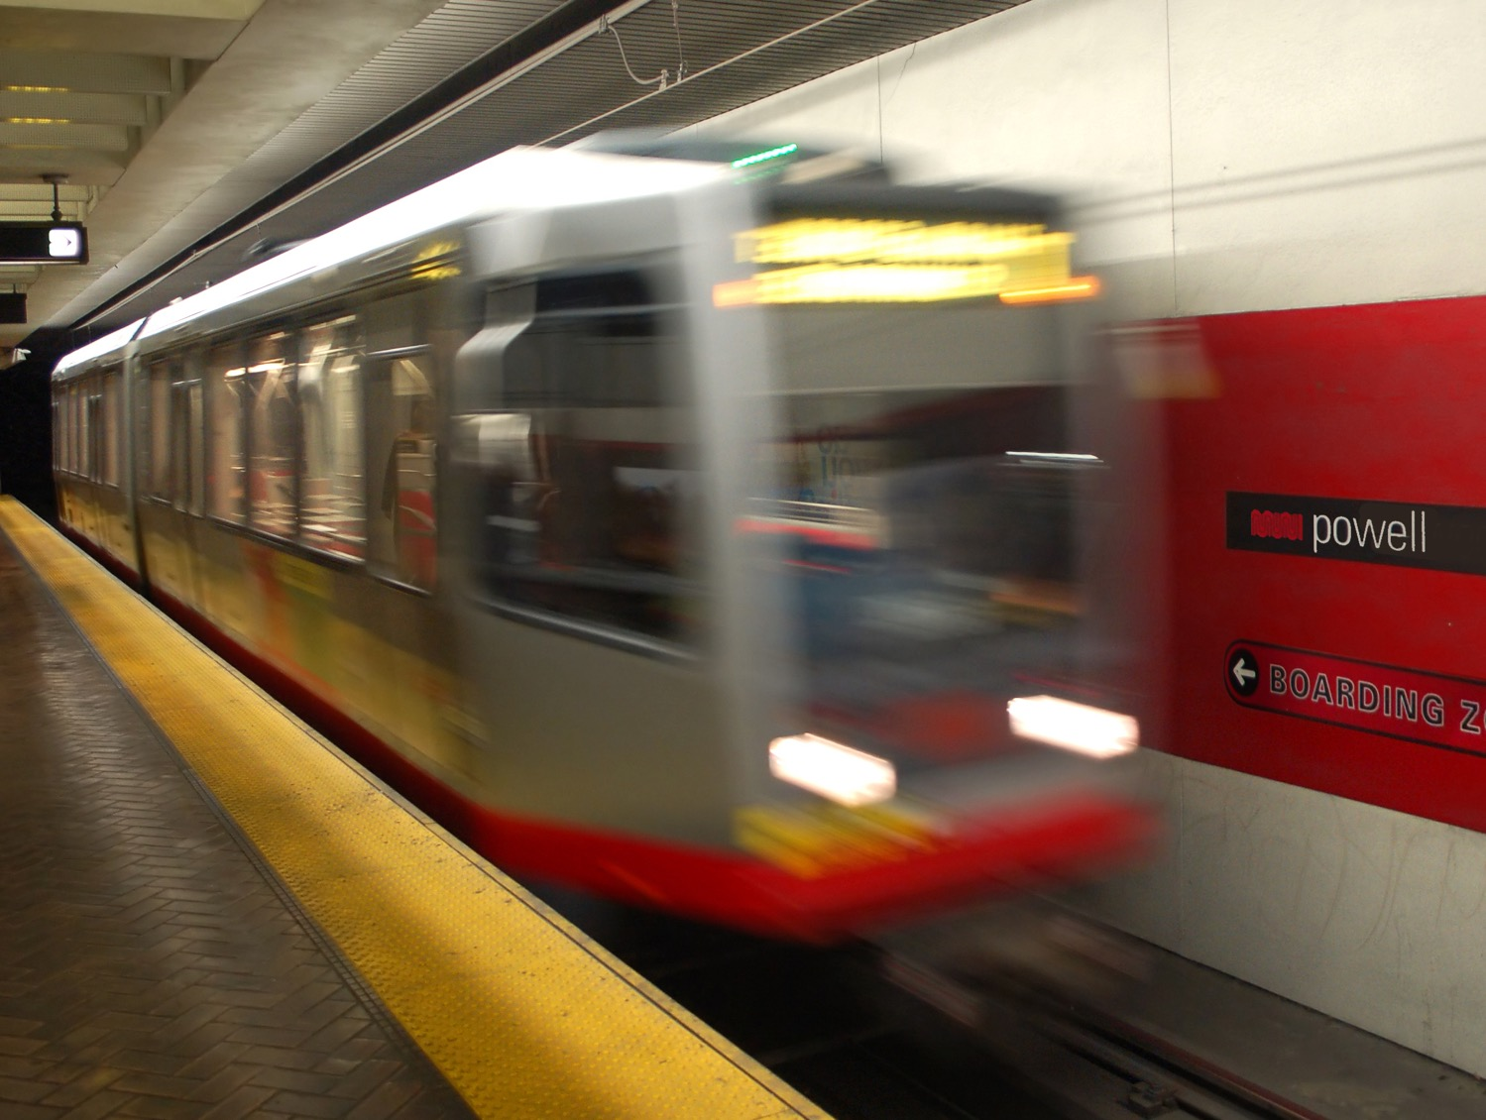
San Francisco Municipal Transportation Agency
Financial Update
San Francisco County Transportation Authority May 13, 2025
Notes:
Meeting welcome and intro

Slide 2
A well-functioning Muni is critical to the Bay Area’s economic recovery
Muni supports the climate, equity and economic recovery goals of the entire region
Muni carries over half of Bay Area transit riders
About 55% of all regional transit trips start or end in San Francisco
Almost half of all Bay Area interagency transit transfers are to or from Muni
“If we don’t have a solvent transit agency, we will never have economic recovery.” –Ted Egan, San Francisco’s Chief Economist
Notes:
I really wanted to emphasize the importance of Muni not just for San Francisco, but for the entire Bay Area.
We’re committed to a strong Bay Area – to helping achieve our region’s climate goals, our equity goals, and—especially important right now—our economic recovery goals.
Muni carries over half of Bay Area transit riders
About 55% of all regional transit trips start or end in San Francisco
Almost half of all Bay Area interagency transit transfers are to or from Muni
Ted Egan, SF’s Chief Economist told the Muni Funding Working Group: “If we don’t have a solvent transit agency, we will never have economic recovery.”

Slide 3
2024 Passenger Trips
Muni delivered 158 million passenger trips in 2024, 13.5 million more than in 2023.
Total Boardings (in Millions)
Data excludes ridership for cable cars and historic streetcars.
Notes:
From analysis of 2024 ridership.

Slide 4
March Muni Ridership
495,000
74% ridership recovery
Weekday
Average Daily Boardings
331,000
90% ridership recovery
Weekend
Note: Excludes cable cars and historic streetcars.
Notes:
From March 2025

Slide 5
In 2024, Muni riders gave us their highest satisfaction rating in 20 years
Customer commendations
Great customer service!
Cable car operator: He's quietly one of the greatest ambassadors for the city.
Great, timely, friendly service!
Driver is always friendly, kind, and considerate
Did his job with kindness and respect.
Great job, especially serving disabled and wheelchair passengers.
Notes:
Muni riders have noticed our improvements: In our 2024 Muni Rider Survey, they gave us their highest satisfaction rating in 20 years.
72% of riders surveyed this year rate Muni as excellent or good.
This is 6% higher than the last time we surveyed Muni riders in 2022.
This slide shows an example of the many commendations our staff receive every day.

Slide 6
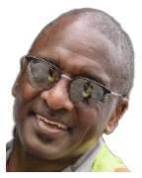
SFMTA Operating Budget
Notes:
Now we turn to the operating budget.

Slide 7
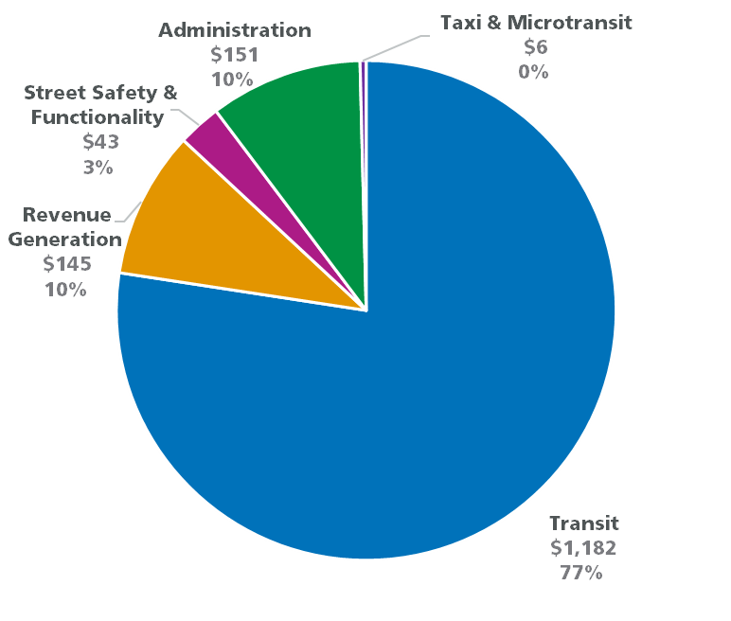
Expenditure by Services
FY 25-26 Expenditure Budget by Service ($M)
Almost 90 percent of the SFMTA expenditures are directly related to delivering Muni service or generating revenue to support Muni service
Most of street safety work is delivered through capital funding sources, including competitive regional and state grants
Administration costs are small and deliver key functions, such as hiring, payroll, grant administration, workers comp, contracts and compliance
Source: FY24-25 and FY25-26 Original Budget, passed by Board of Supervisors July 2024.
Note: Transit includes paratransit.
Notes:
Slide 7 from here: PowerPoint Presentation

Slide 8
Operating Budget Expenditure
FY 25-26 Budgeted Expenditure by Expenditure Type
60% of budget is expended on salaries and benefits for staff.
35% of budget is expended on non-labor, the services and supplies staff use to do their job.
5% of budget is expended on debt service and retiree health, contractual obligations that cannot be changed.
Non-Labor
35%
Materials & Supplies,
7%
Non
Personnel,
19%
Debt Service & Retiree Health,
5%
Source: FY25-26 Original Budget, passed by Board of Supervisors July 2024
Notes:
Slide 7 from here: PowerPoint Presentation

Slide 9
Labor: Transit
FY25-26 Budgeted Transit FTEs
Delivering transit requires more than transit operators.
Source: FY25-26 Original Budget, passed by Board of Supervisors July 2024. Note: Excludes attrition and temporary staff. Transit includes paratransit.
Notes:
Slide 7 from here: PowerPoint Presentation

Slide 10
Operating Budget Revenue
FY 25-26 Budgeted Revenue
30% revenue generated by the SFMTA:
Transit Fares, Parking Revenue, Other Revenue, and Fund Balance.
70% revenue from external sources:
CCSF Support, State & Regional Support, and One-time Federal, State, & Regional Relief.
17% Expiring FY26-27: One-time Federal, State, and Regional Relief fully expended by June 2026.
External Sources 70%
Source: FY25-26 Original Budget, passed by Board of Supervisors July 2024.
Notes:
Slide 7 from here: PowerPoint Presentation

Slide 11
Transit Fares
Transit Fare Revenues (Actuals/Projected $M)
Transit fares are lower than pre-pandemic but have been growing with ridership and increased fare compliance.
Source: FY24-25 projected revenue based on April 2025 9-month report.
Regional fare collection upgrades and continued enforcement have potential to increase transit fares, but even pre-pandemic fares are insufficient to close gap.
Notes:
Page 35 of this ppt download
Is this the "transit"piece of the pie above, that makes up 7%?

Slide 12
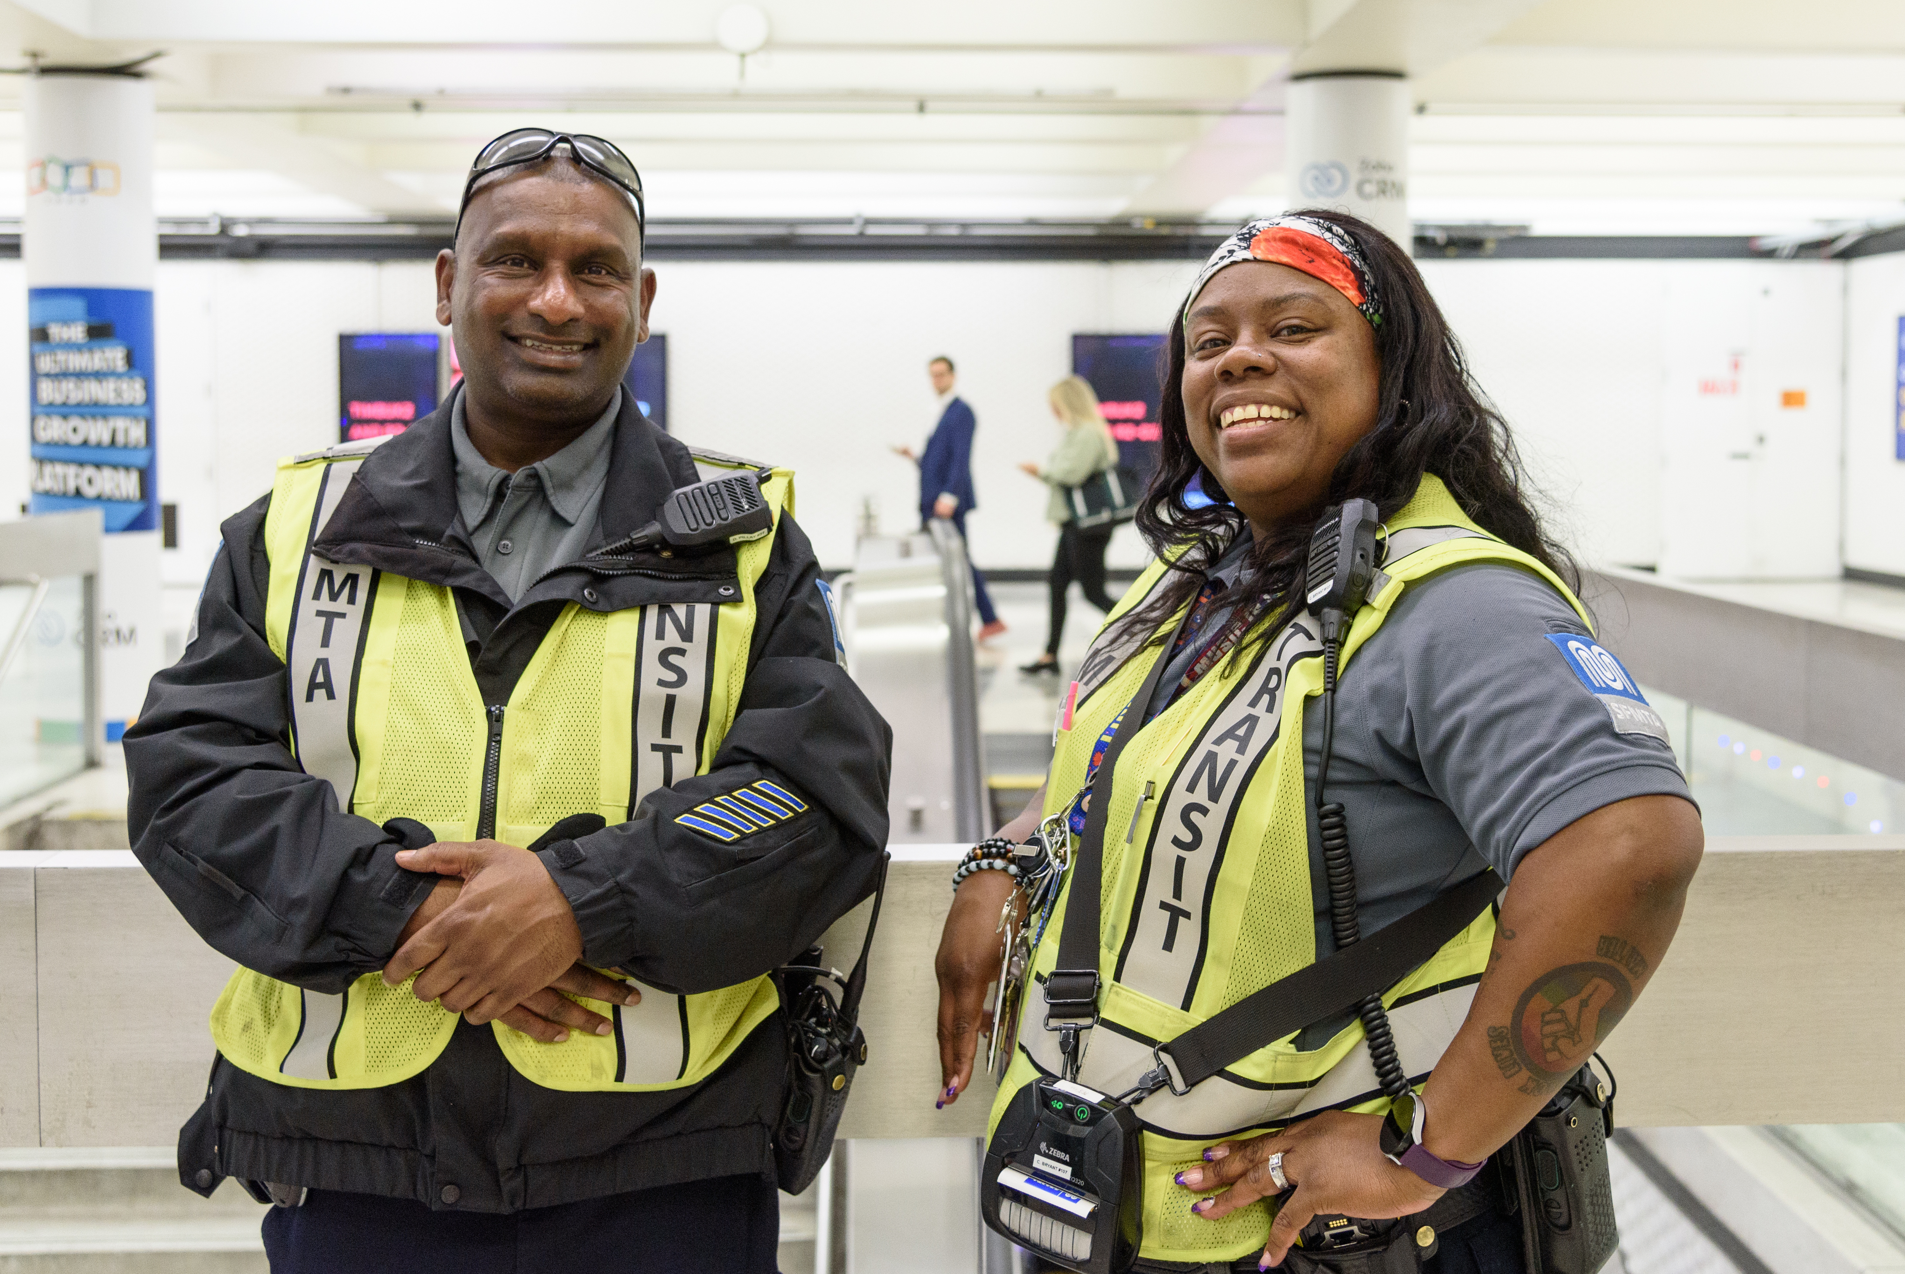
Transit Fare Compliance
Addressing visible fare evasion helps build public trust in Muni. Riders have asked to see action.
The SFMTA approaches Fare Compliance with San Francisco values in mind:
Safety
Equity
Education
We have stepped up our efforts and we are seeing results:
Increased by
100%
Monthly Fare Inspections
Decreased by
30%
TFI Observed Fare Evasion
Increased by
6%
Revenue per Rider

Slide 13
Parking Revenue
Parking Revenue (Actuals/Projected $M)
Parking revenue is down 14% compared to pre-pandemic, decreasing funding for transit service.
Source: FY24-25 projected revenue based on April 2025 9-month report.
Note: Include Seventh & Harrison Lot to tie to year-end financial data

Slide 14
Parking Garage Revenue
Positive financial trends at neighborhood and Civic Center garages outweighed by significantly reduced utilization of downtown garages.
Parking Revenue (Actuals/Projected $M)
Source: FY24-25 projected revenue based on April 2025 9-month report.
Note: Does not include Seventh & Harrison Lot due to insufficient data for comparison. Reflects budgeted parking revenue.

Slide 15
Generating More Revenue
Grew Muni ridership by improving service​ quality/customer experience
Increased Muni fare compliance by adding transit fare inspectors and optimizing inspections​
Increased fares, fees and fines starting in July 2024, projected to generate $13M​ across two-year budget
Optimizing existing parking programs with goal of generating $18M per year beginning in FY25-26
Shifted some capital funding to operations​
SFMTA has taken action to raise revenue

Slide 16
Efficiencies to date
Saved $90 million in personnel costs annually by reducing hiring and holding positions vacant (work underway to remove vacant defunded positions from FY25-26 budget)
Cut $30 million in non-personnel costs by eliminating planned one-time investments in FY24-25 and FY25-26
Offering a dozen fewer Muni routes than pre-pandemic and only added Muni service if service was cut elsewhere in the system
In June, will cut Muni service by 2% without eliminating any Muni routes
Installed 100 miles of transit-only lanes and implemented other reliability improvements that allow Muni buses to get to their destinations more quickly – allowing SFMTA to deliver more Muni service at no additional cost
Used technology to optimize operations (i.e. self-pay at parking garages, self-scheduling of tow hearings)
SFMTA managed lower revenue by becoming more efficient.

Slide 17
By cutting spending and becoming more efficient, we reduced the FY26-27 budget gap from $440M+ to $320M.
Notes:
Let’s start w the revenue we do have control over.

Slide 18
Deficit
FY 26-27 ----- $322M
FY 27-28 ----- $349M
The projected deficit:
The projected deficit is $322M in FY26-27 and grows with inflation over time
Operating Source by Type ($M)
Local and State Revenue
Enterprise Revenue
Federal, State, and Regional Relief
Projected Deficit
Projected
Expenditure

Slide 19
Muni Funding Working Group
In fall 2024, the Muni Funding Working Group began work to identify approximately $320 million to sustain Muni service and the other transportation services San Francisco relies on after federal and state relief funds are exhausted.
Led by the Controller’s Office, the Working Group reviewed and prioritized policy options that SFMTA can implement to address its short-term funding gap and long-term structural deficit.
The Working Group discussed and provided feedback on packages of options for stakeholders and elected policy makers to consider.
SFCTA | May 13, 2025

Slide 20
Muni Funding Working Group Members
Members represented a diverse group of stakeholders
Member | Organization or Group
Chris Arvin | MTA Citizens’ Advisory Council
Anthony Ballester | Transport Workers Union
Alicia John-Baptiste | Mayor’s Office
Desira Brown | Tenderloin Neighborhood Development Corporation
Tilly Chang | San Francisco County Transportation Authority
Rodney Fong | SF Chamber of Commerce
Kristin Hardy | SEIU
Jon Hee | Chinatown Transportation Research and Improvement Project
Steve Heminger | SFMTA Board
Fiona Hinze | SFMTA Board
Sara Johnson | San Francisco Transit Riders
Kathleen Kelly | Transportation Expert
Julie Kirschbaum | SFMTA Director (non-voting member)
Member | Organization or Group
Rafael Mandelman | Board of Supervisors and San Francisco County Transportation Authority
Myrna Melgar | Board of Supervisors and San Francisco County Transportation Authority
Robin Pam | KidSafe
Seleta Reynolds | LA Metro
Mia Satya | Senior & Disability Action
Alex Sweet | Mayor’s Transportation Advisor
Kim Tavaglione | SF Labor Council
Laurie Thomas | Golden Gate Restaurant Association
Laura Tolkoff | SPUR
Greg Wagner | Office of the Controller (non-voting member)
SFCTA | May 13, 2025

Slide 21
Muni Funding Working Group Work Plan
The Muni Funding Working Group reviewed individual options in the following categories:
Efficiency Improvements: streamline systems and processes to decrease operating costs.
Service Cuts: reduce service to decrease operating costs.
Funding Options: increase fees, revenue, or taxes to increase overall revenue.
Service Improvements: enhance services to win voter support for new revenue.
SFMTA then bundled individual options into six packages based on Working Group feedback of individual options.
SFCTA | May 13, 2025

Slide 22
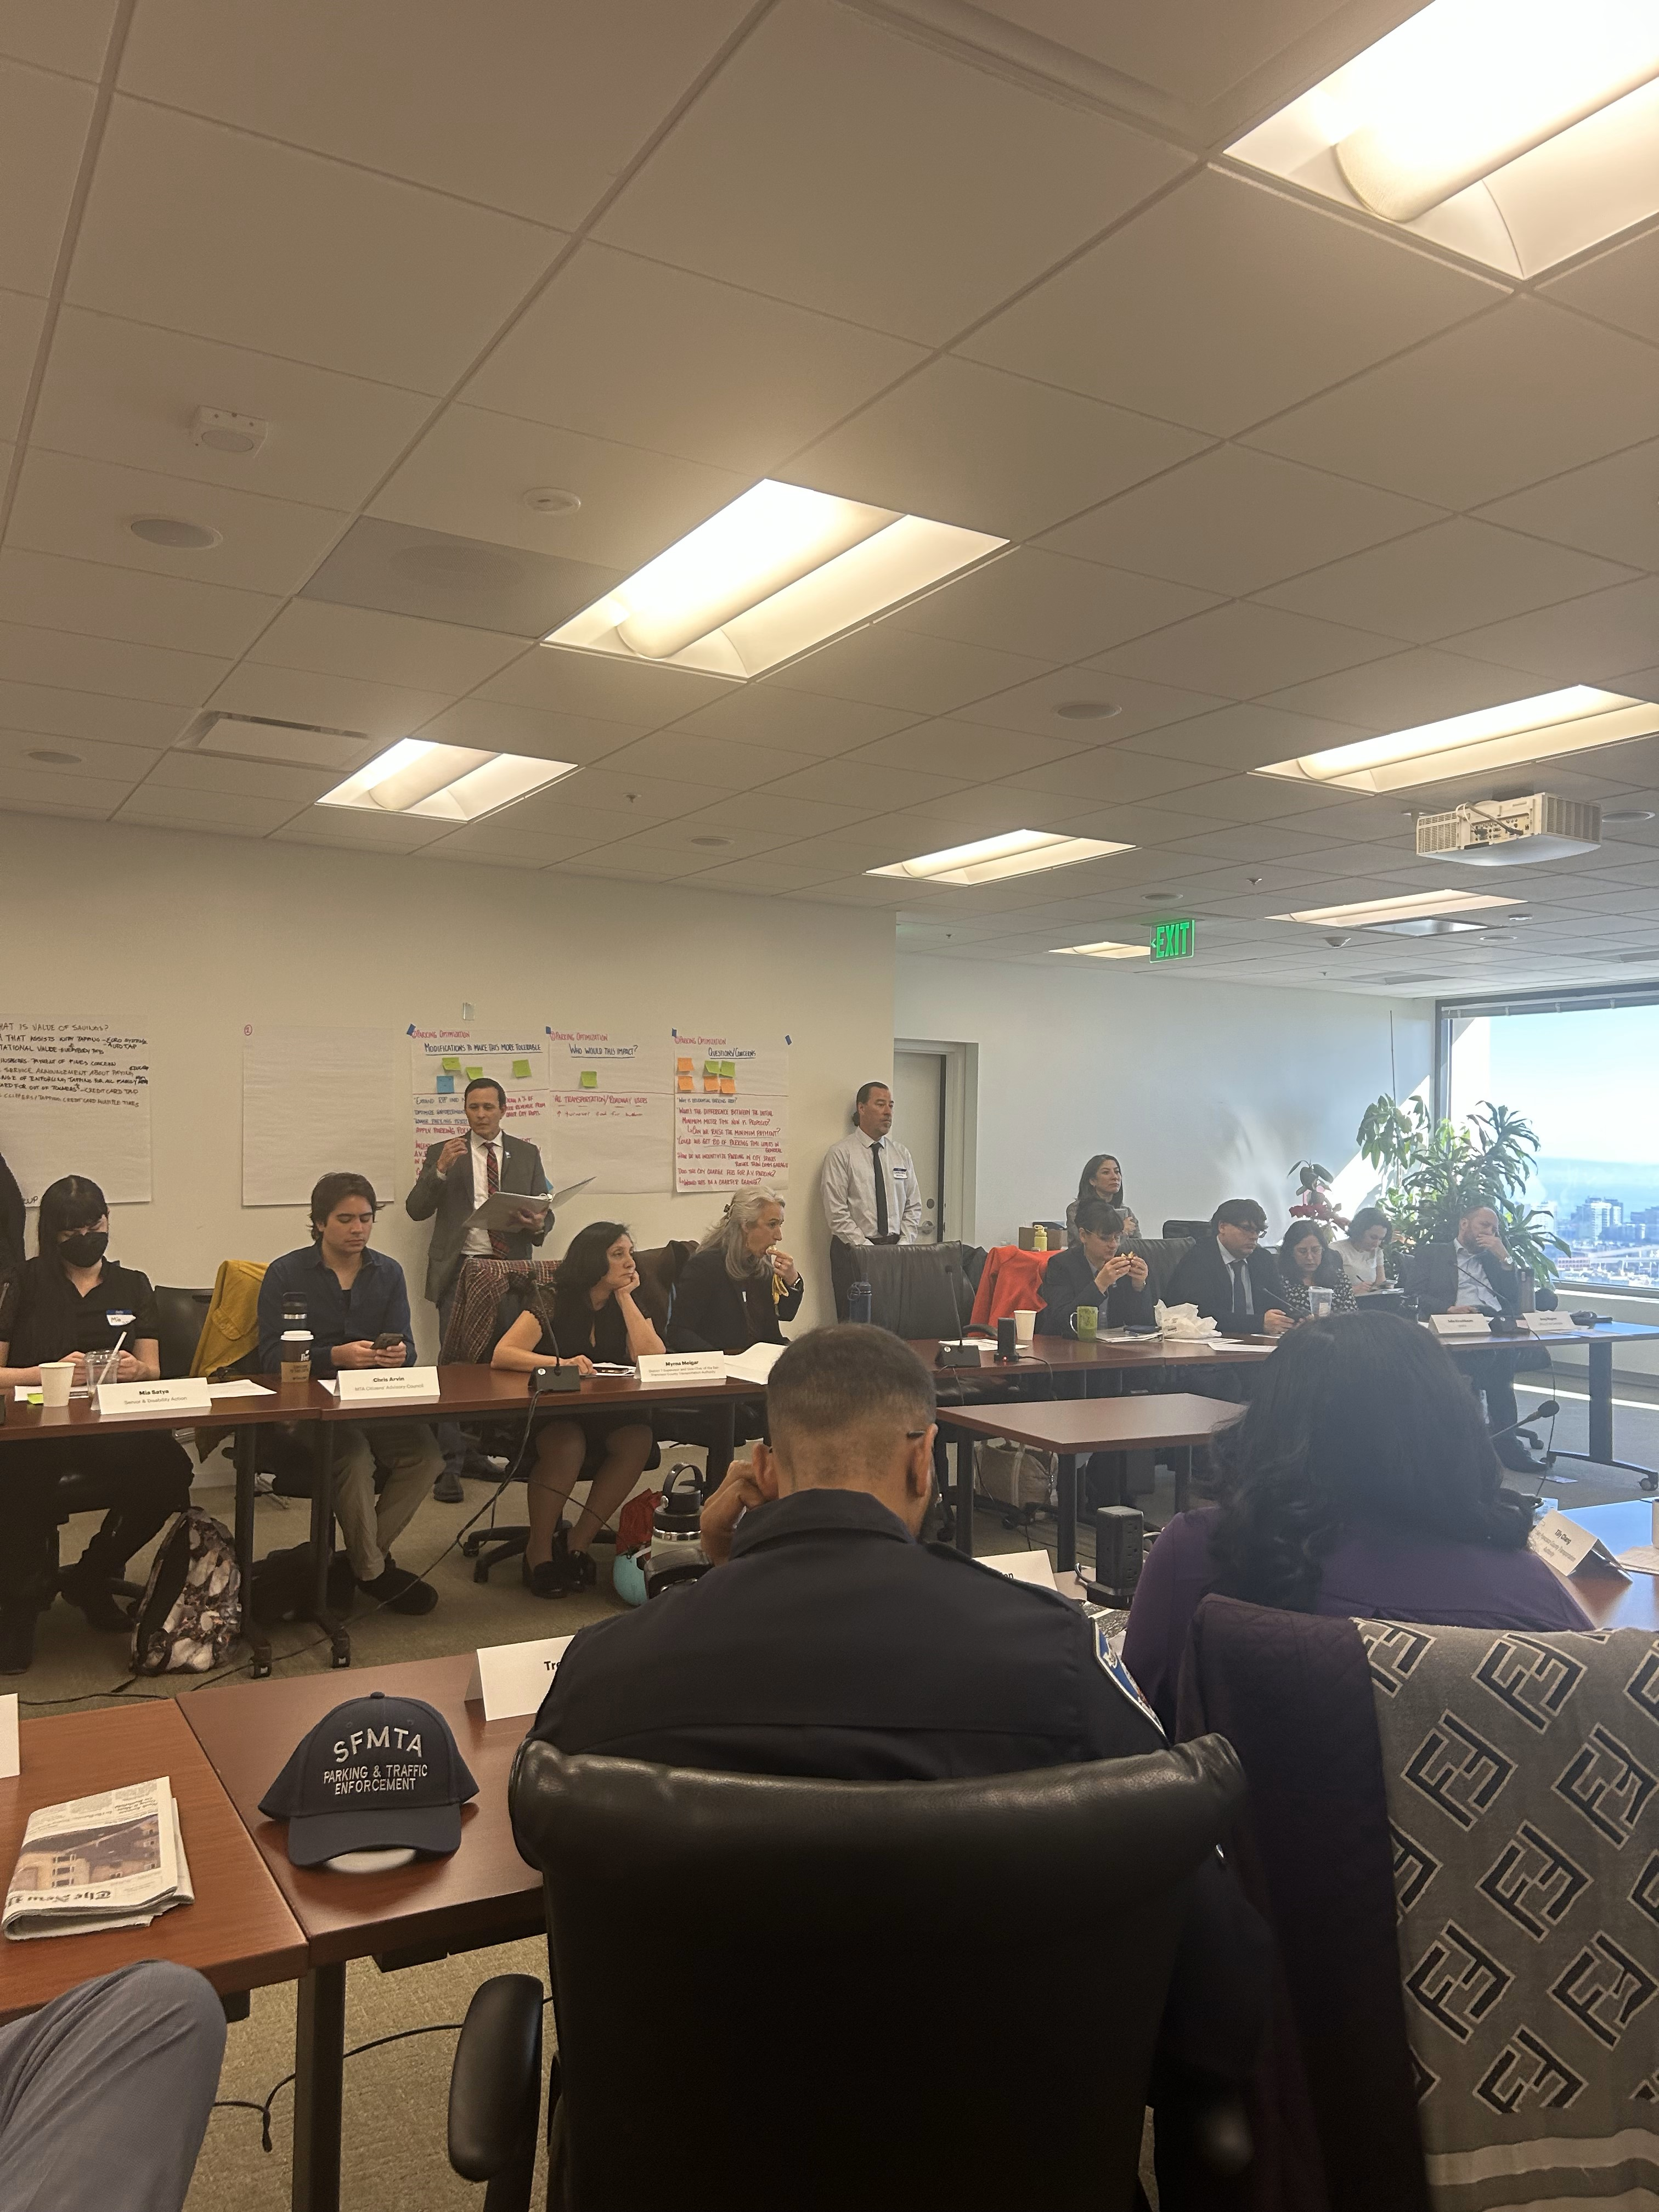
POLICY OPTIONS
Efficiencies & Internal Cuts​
Administrative Cuts
Parking Optimization
Transit Fare Optimization
Automated Parking Enforcement
Large Ballot Measures​
Regional Measure
Local Sales Tax
Local Parcel Tax
Small Ballot Measures
Up to $50 million total
​

Slide 23
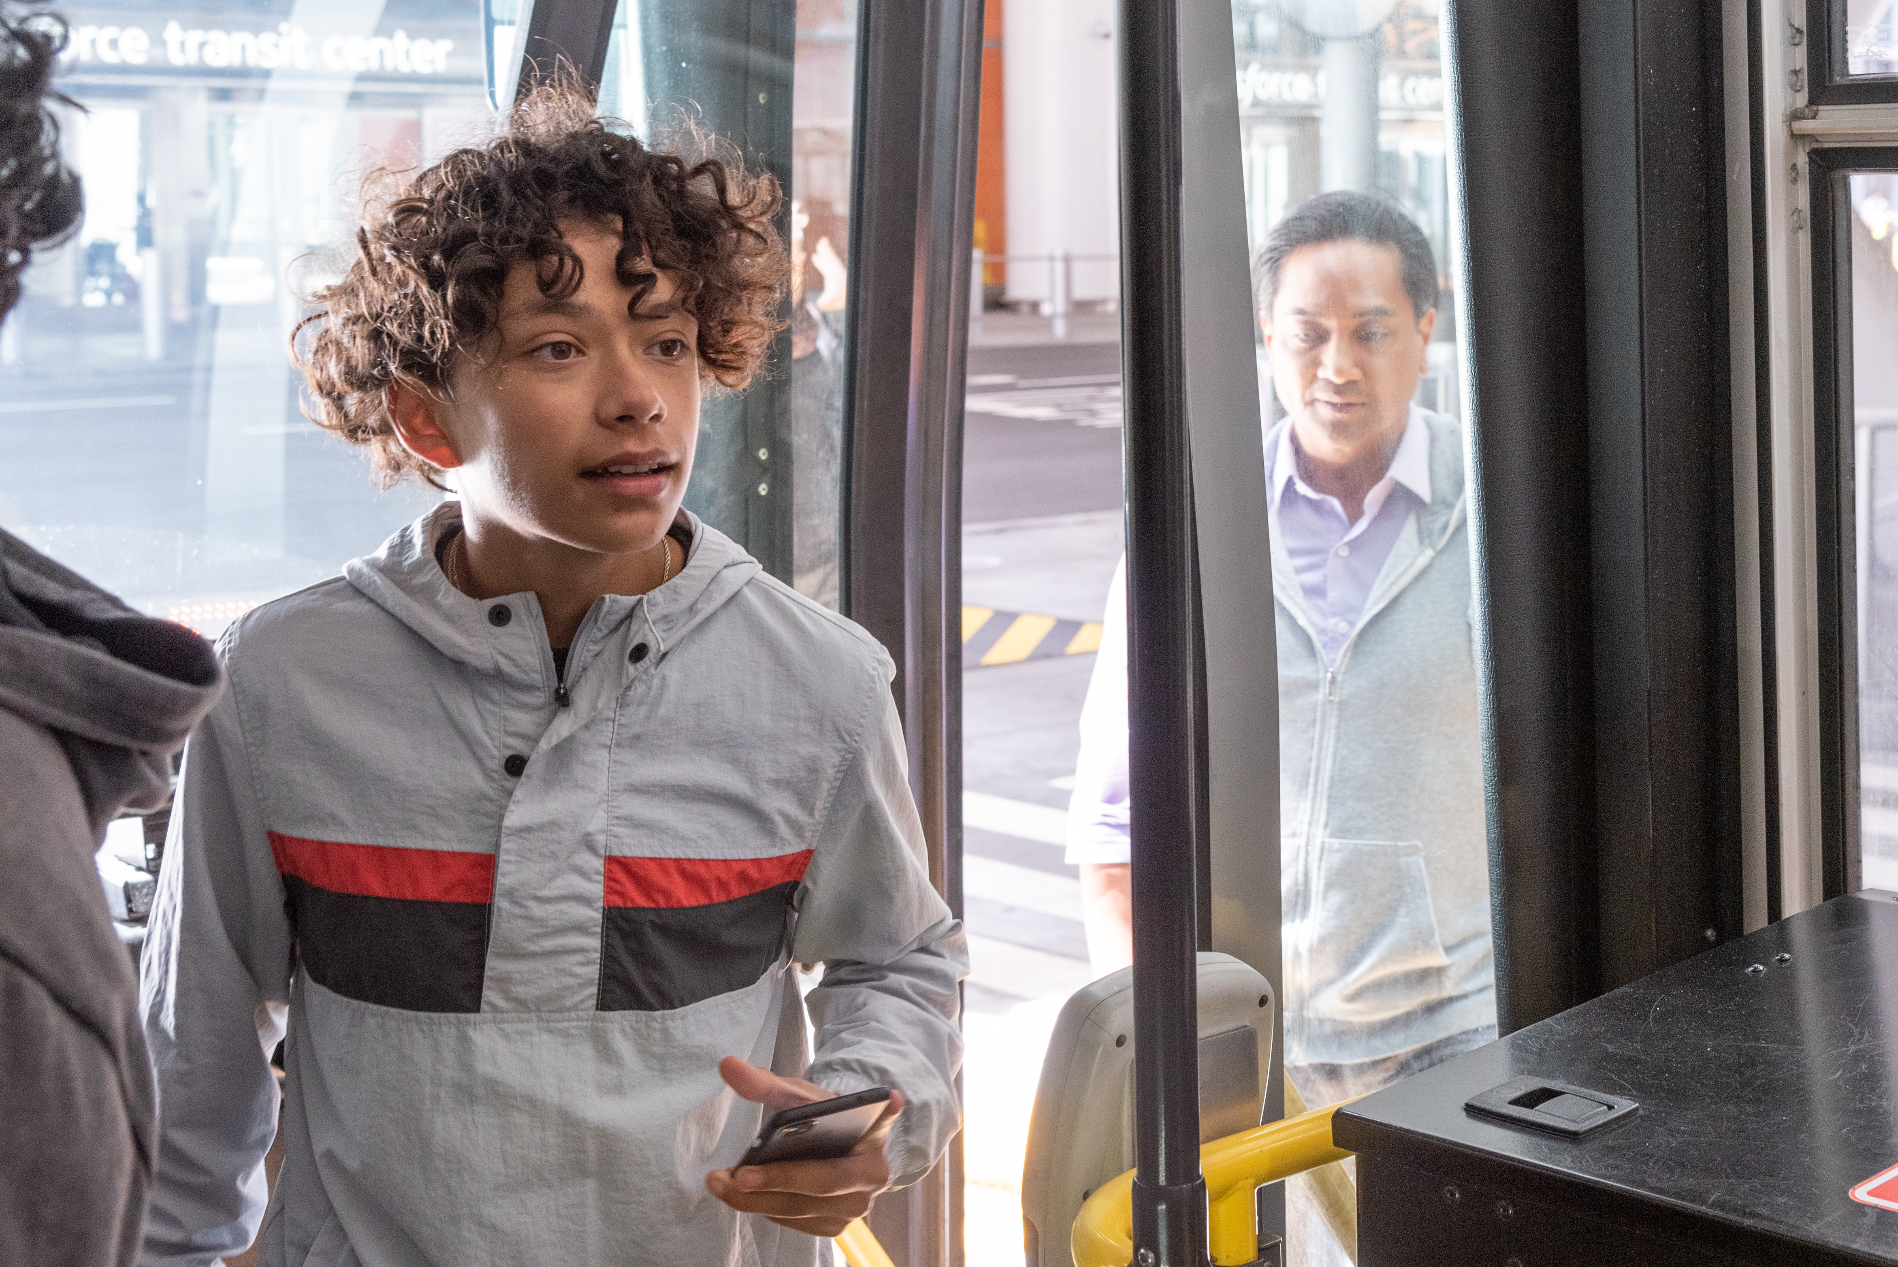
POLICY OPTIONS (CONT.)
Non-Ballot Revenue​
Visitor Paid Parking
Sunday Paid Parking
Evening Paid Parking
Increase Residential Permit Fee
Subsidy Reductions​
Eliminate or Reduce Fare Subsidies
Eliminate or Reduce Tow Subsidies
Non-Muni Cuts
Constituent Services Reductions
Street Maintenance Reductions
Safety Work Reductions​
Muni Service Cuts

Slide 24
ASSUMPTIONS
We are guided by the following assumptions:
Solving for Muni and regional partner funding needs is critical – Every package includes some level of funding from a regional ballot measure.
There is no single solution – Every package includes new revenues and program/subsidy cuts.
Bridge funding is needed to cover FY26-27 budget gap – Senators Wiener & Arreguin are spearheading a State Budget effort to secure funds.
Packages rely on ongoing funding sources, not one-time fixes – Some packages include components that likely cannot be implemented until 2028. Capital budget cuts could be implemented as a bridge to fill the gap until then.
Revenues and costs savings are estimates for planning purposes – Amounts are likely to change in the coming months, given the level of uncertainty.

Slide 25
ASSUMPTIONS: SELF HELP
SFMTA committed to implement efficiencies and internal cuts, which is critical to building support for all solutions.
In addition to the savings we have achieved to date, all packages include:
At least $10M in administrative cuts
$18M from optimizing parking revenues
$5M in transit fare optimization (from increased fare compliance)
$3M in accelerating Muni Forward improvements
$7.2M in Muni service reductions will be added in future iterations of the packages.​

Slide 26
PACKAGE OVERVIEW
Policy Options by $millions
Category | Package A: | Package B: | Package C: | Package D: | Package E: | Package F:
Efficiencies & Internal Cuts | $40M | $40M | $37M | $44M | $42M | $45M
Large Ballot Measures | $260M | $210M | $211M | $168M | $187M | $137M
Small Ballot Measures | - | $50M | $43M | $25M | - | -
Non-Ballot Revenue | $20M | $20M | - | $49M | $36M | $14M
Subsidy Reductions | - | - | $15M | - | $3M | $15M
Non-Muni Cuts | - | - | $14M | $11M | $11M | $18M
Muni Service Cuts | - | - | - | $23M | $41M | $91M
Total | $320M | $320M | $320M | $320M | $320M | $320M
Raising
Revenue
Reducing Costs
Through Cuts

Slide 27
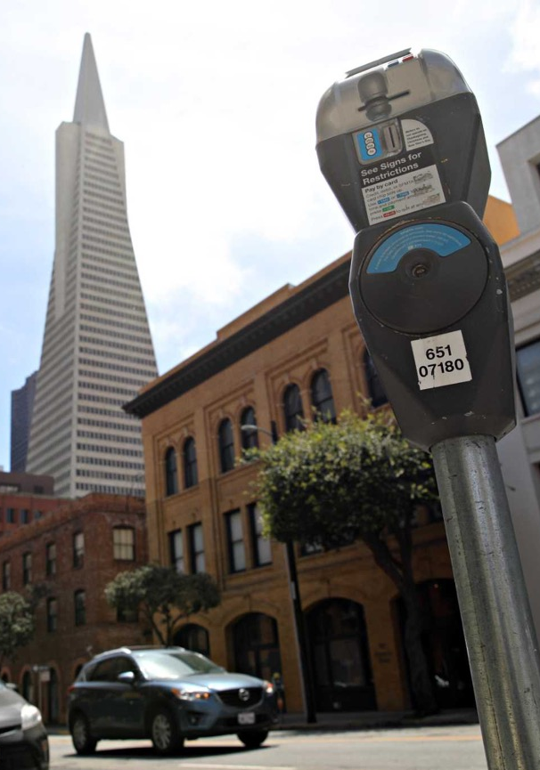
SFMTA Budget Strategy
Muni Funding Working Group helped build local consensus
Closing the funding gap is going to take a package that includes a variety of funding options
Pursue revenue measures for 2026 with regional and state partners
Develop a fiscally responsible FY 26-27 and FY 27-28 budget
Fight for funding to make sure San Francisco has the transportation services it needs and deserves

Slide 28
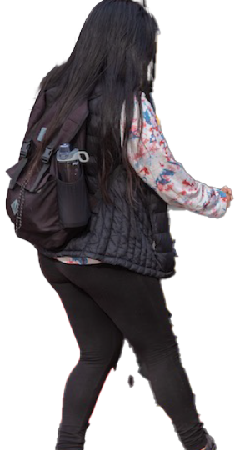
Thank you! Questions?
Notes:
Thank you for listening! We now have time for your questions and comments.

Slide 29
Appendix: Muni Funding Working Group Package Details
Notes:
Now we turn to the operating budget.

Slide 30
PACKAGE OVERVIEW
Policy Options by percent of total ($320M)
Category | Package A: | Package B: | Package C: | Package D: | Package E: | Package F:
Efficiencies & Internal Cuts | 13% | 13% | 12% | 14% | 13% | 14%
Large Ballot Measures | 81% | 66% | 66% | 53% | 58% | 43%
Small Ballot Measures | 0% | 16% | 13% | 8% | 0% | 0%
Non-Ballot Revenue | 6% | 6% | 0% | 15% | 11% | 4%
Subsidy Reductions | 0% | 0% | 5% | 0% | 1% | 5%
Non-Muni Cuts | 0% | 0% | 4% | 3% | 3% | 6%
Muni Service Cuts | 0% | 0% | 0% | 7% | 13% | 28%
Total | 100% | 100% | 100% | 100% | 100% | 100%
Raising
Revenue
Reducing Costs
Through Cuts

Slide 31
DISCLAIMER
Any of the measures or programs included in any ‘Package’ are for the purposes of discussion and feedback. These ‘Packages’ incorporate the feedback and suggestions of Muni Funding Working Group (MFWG) members, survey data, outreach and analysis by SFMTA staff.
Given the real-time, dynamic nature of forecasting revenues and actual collections, the numbers stated in this presentation are subject to change. We cannot perfectly predict the future, and these packages today, reflect what we know now. We must plan for both risk and uncertainty.
Any final implementation plan eventually developed will have to be resilient to changing conditions with contingencies in place. As of today, none of the included options are officially endorsed actions or plans by the SFMTA.

Slide 32
Package A: Preserve Muni & Street Safety – Big at the Ballot in 2026
Preserves all existing services and subsidies with minor cuts to Administrative functions.
Pursues two (2) large ballot measures to generate most of the funds needed including a regional revenue measure and a local parcel tax.
Closes the gap with parking initiatives.
Generating New Revenue | Reducing Costs Through Cuts
Large Ballot Measures (2026) $162M Regional Revenue Measure (Variable Rate) $98M Local Parcel Tax ($0.175/sq ft) Non-Ballot Revenues $20M SF Visitor Paid Parking (2028+) | Efficiencies & Internal Cuts $10M Administrative Cuts $4M Automated Parking Enforcement
As a baseline, all packages maximize three existing programs to generate revenue, including parking optimization ($18M), transit fare optimization ($5M), and accelerating Muni Forward improvements ($3M), and includes differing levels of Administrative Cuts.
Notes:
Note that Visitor parking does not increase RPP over cost recovery

Slide 33
PACKAGE A:
Preserve Muni & Street Safety - Big at the Ballot in 2026
This package assumes a scenario in which there are no Muni Service cuts, Street Safety cuts or subsidy reductions. This requires a high-level of political support and is therefore a high-risk scenario as it is dependent on voter approval of two large ballot measures in 2026.
Non-Ballot Revenue: 6%
$20M
Efficiencies & Internal Cuts: 13%
$40M
$260M
Large Ballot Measures: 81%

Slide 34
Package B: Preserve Muni & Street Safety – Multiple Ballots over Time
Like Package A, preserves all existing services and subsidies – no Muni Service cuts, Street Safety cuts or subsidy reductions.
Requires significant political support to generate needed revenue across three (3) ballot measures in 2026 and 2028.
Closes the gap with parking fees.
Generating New Revenue | Reducing Costs Through Cuts
Large Ballot Measures (2026) $162M Regional Revenue Measure (Variable Rate) $48M Local Parcel Tax ($0.067/sq ft) Small Ballot Measures (2028) $50M in total Non-Ballot Revenues $20M SF Visitor Paid Parking (2028+) | Efficiencies & Internal Cuts $10M Administrative Cuts $4M Automated Parking Enforcement
As a baseline, all packages maximize three existing programs to generate revenue, including parking optimization ($18M), transit fare optimization ($5M), and accelerating Muni Forward improvements ($3M), and includes differing levels of Administrative cuts.

Slide 35
PACKAGE B:
Preserve Muni & Street Safety – Multiple Ballots over Time
This package assumes a scenario in which there are no Muni Service cuts, Street Safety cuts or subsidy reductions. This requires a high-level of political support as it is dependent on voter approval of two large-ballot measures in 2026 and a smaller measure in 2028.
Non-Ballot Revenue: 6%
$20M
Efficiencies & Internal Cuts: 12%
$40M
Small Ballot Measure: 16%
$50M
Large Ballot Measures: 66%
$210M

Slide 36
Package C: Protecting Muni Service – Minimizing Cuts for Riders
Like the previous Packages, this option preserves Muni Service.
Requires significant political support to generate needed revenue across three (3) ballot measures in 2026 and 2028.
Does NOT seek additional revenues outside of the ballot, i.e. parking fees.
Introduces cuts to Non-Muni programs and reduces tow and fare subsidies.
Generating New Revenue | Reducing Costs Through Cuts
Large Ballot Measures (2026) $162M Regional Revenue Measure (Variable Rate) $49M Local Sales Tax Small Ballot Measure (2028) $43M in total | Efficiencies and Internal Cuts $11M Administrative Cuts Non-Muni Cuts $7M Constituent Services Reductions $4M Streets Maintenance Reduction $3M Safety Work Reductions Subsidy Reductions $3M Eliminate/Reduce Tow Subsidies $12M Eliminate/Reduce Fare Subsidies
As a baseline, all packages maximize three existing programs to generate revenue, including parking optimization ($18M), transit fare optimization ($5M), and accelerating Muni Forward improvements ($3M), and includes differing levels of Administrative Cuts.

Slide 37
PACKAGE C:
Protecting Muni Service – Minimizing Cuts for Riders
This package assumes a scenario in which Muni service cuts for riders are avoided. This requires a high level of political support for voter approval of two large-ballot measures in 2026 and a smaller measure in 2028. It avoids new parking fees but includes reductions in fare subsidies, tow subsidies, and street safety cuts.
Non-Muni Cuts: 4%
$14M
Subsidy Reductions: 5%
$15M
Efficiencies & Internal Cuts: 12%
$37M
Small Ballot Measure: 13%
$43M
$211M
Large Ballot Measures: 66%

Slide 38
Package D: More Reliance on Non-Ballot Revenue
Dependent on Regional Discussions, this package demonstrates what is needed if the smaller regional revenue measure is implemented.
Proposes a Small ballot measure in 2028 totaling $25M.
Requires multiple parking fees, Muni and non-Muni service cuts to make up for lost revenue.
Generating New Revenue | Reducing Costs Through Cuts
Large Ballot Measures (2026) $88M Regional Revenue Measure (Option 1A) $80M Local Parcel Tax ($0.114/sq ft) Small Ballot Measure (2028) $25M in Total Non-Ballot Revenues $30M SF Visitor Paid Parking (2028+) $6M Extend Paid Parking to Sunday $8M Extend Paid Parking to 10 p.m. $5M Increase Residential Parking Permit Fee | Efficiencies & Internal Cuts $14M Administrative Cuts $4M Automated Parking Enforcement Non-Muni Cuts $7M Constituent Services $4M Streets Maintenance Reduction Muni Service Cuts $23M Muni Service Cuts
As a baseline, all packages maximize three existing programs to generate revenue, including parking optimization ($18M), transit fare optimization ($5M), and accelerating Muni Forward improvements ($3M); and includes differing levels of Administrative Cuts.

Slide 39
PACKAGE D:
More Reliance on Non-Ballot Revenue
This package assumes a scenario with some Muni service cuts. This depends less on the ballot for revenues and requires expanded and increased parking fees. Political support is still needed for three ballot initiatives over multiple elections in 2026 and 2028.
Non-Muni Cuts: 3%
$11M
Small Ballot Measure: 8%
$25M
Muni Service Cuts: 7%
$23M
$44M
Efficiencies & Internal Cuts: 14%
Non-Ballot Revenues: 15%
$49M
$168M
Large Ballot Measures: 53%

Slide 40
Package E: Cuts Due to Less Opportunity at the Ballot
Includes the smaller regional revenue measure and a complementary Local Sales Tax.
Eliminates any smaller ballot measure in 2028 given limited political support.
Requires expansion of Pay or Permit and Sunday Paid Parking.
Additional Muni service cuts are required to close the gap.
Generating New Revenue | Reducing Costs Through Cuts
Large Ballot Measures (2026) $88M Regional Revenue Measure (Option 1A) $99M Local Sales Tax (1/2-cent) Non-Ballot Revenues $30M SF Visitor Paid Parking (2028+) $6M Extend Paid Parking to Sunday | Efficiencies & Internal Cuts $16M Administrative Cuts Non-Muni Cuts $7M Constituent Services Reductions $4M Streets Maintenance Reductions Muni Service Cuts $41M Muni Service Cuts Subsidy Reductions $3M Eliminate/Reduce Tow Subsidies
As a baseline, all packages maximize three existing programs to generate revenue, including parking optimization ($18M), transit fare optimization ($5M), and accelerating Muni Forward improvements ($3M); and includes differing amounts of Administrative Cuts.

Slide 41
PACKAGE E:
Cuts Due to Less Opportunity at the Ballot
This package assumes a scenario in which Muni cuts for riders are necessary. This requires a moderate level of political support for two ballot initiatives in 2026, street safety cuts and expanded and increased parking fees.
Subsidy Reductions: 1%
$3M
Non-Muni Cuts: 3%
$11M
Efficiencies & Internal Cuts: 11%
$35M
Non-Ballot Revenues: 11%
$36M
$41M
Muni Service Cuts: 15%
Large Ballot Measures: 58%
$187M

Slide 42
Package F: Fewer Options, More Cuts
Demonstrates actions needed with minimal public support at the ballot.
Requires significant Muni service cuts, non-Muni cuts, and subsidy eliminations to close the gap.
Paid parking expansion included.
Generating New Revenue | Reducing Costs Through Cuts
Large Ballot Measures (2026) $88M Regional Revenue Measure (Option 1A) $49M Local Sales Tax Non-Ballot Revenues $6M Extend Paid Parking to Sunday $8M Extend Paid Parking to 10 p.m. | Efficiencies & Internal Cuts $19M Administrative Cuts Non-Muni Cuts $7M Constituent Services Reductions $4M Streets Maintenance Reduction $7M Safety Work Reductions Muni Service Cuts $91M Muni Service Cuts Subsidy Reductions $12M Eliminate or Reduce Fare Subsidies $3M Eliminate or Reduce Tow Subsidies
As a baseline, all packages maximize three existing programs to generate revenue, including parking optimization ($18M), transit fare optimization ($5M), and accelerating Muni Forward improvements ($3M); and includes differing levels of Administrative Cuts.

Slide 43
PACKAGE F:
Fewer Options, More Cuts
This package assumes a scenario in which Muni cuts for riders are necessary. This requires two ballot initiatives to pass. However, revenues are not enough. Significant cuts to Muni service, street safety, elimination of fare and tow subsidies, and expanded and increased parking fees are needed to close the gap.
Non-Ballot Revenues: 4%
$14M
Subsidy Reductions: 5%
$15M
Non-Muni Cuts: 6%
$18M
..
$45M
Efficiencies & Internal Cuts: 14%
$91M
Muni Service Cuts: 28%
$137M
Large Ballot Measures: 43%

