Slide 1
SFMTA and SF Paratransit COVID-19 Transportation Update
Presented By:
Annette Williams - Manager of Accessible Services, SFMTA

Slide 2
Muni COVID-19 Response
Muni is only for essential trips and for those who have no other transportation options.
The safety of Muni customers and operators is of utmost importance.
Muni has implemented service reductions due to a number of safety considerations.
Muni riders are required to wear face coverings or masks and maintain social distancing.

Slide 3
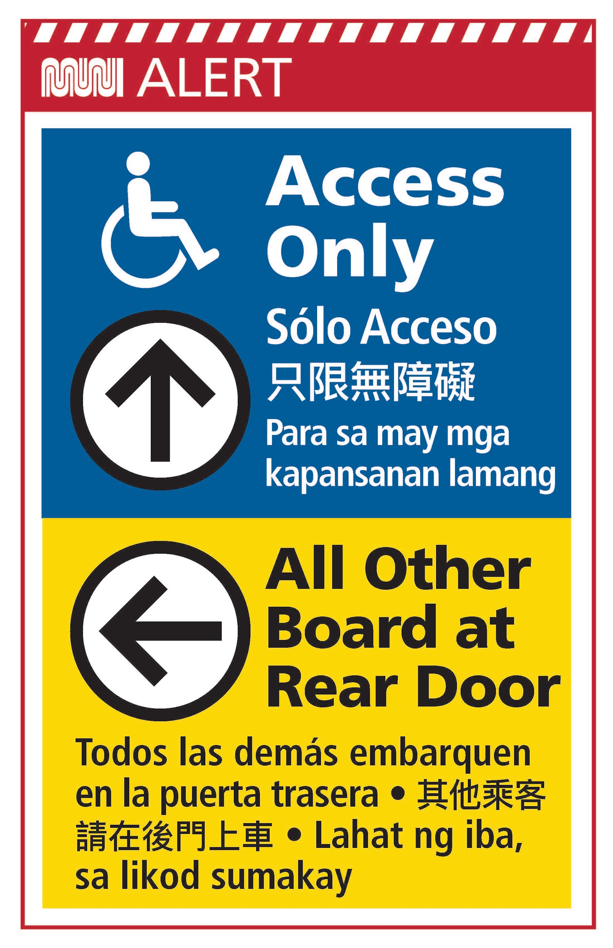
Changes When Riding Muni

Slide 4
Changes When Riding Muni
Masks/face coverings now required when riding

Slide 5
Muni Core Service Plan
Running 17 of 79 lines
These lines carried 80% of total passengers
N Judah Bus L Taraval Bus T Third Bus 1 California 8 Bayshore 9 San Bruno 14 Mission 14R Mission Rapid 19 Polk | 22 Fillmore 24 Divisadero 25 Treasure Island 29 Sunset 38 Geary 38R Geary Rapid 44 O'Shaughnessy 49 Van Ness/Mission

Slide 6
Modified Core Service Plan
Restored some service on April 25
Increases coverage across city and connects to additional essential services
Added lines: 5 Fulton 12 Folsom/Pacific 28 19th Avenue 54 Felton 714 BART - Early Bird Shuttle | More Service: N Judah Bus L Taraval Bus 9 San Bruno 38R Geary Weekends

Slide 7
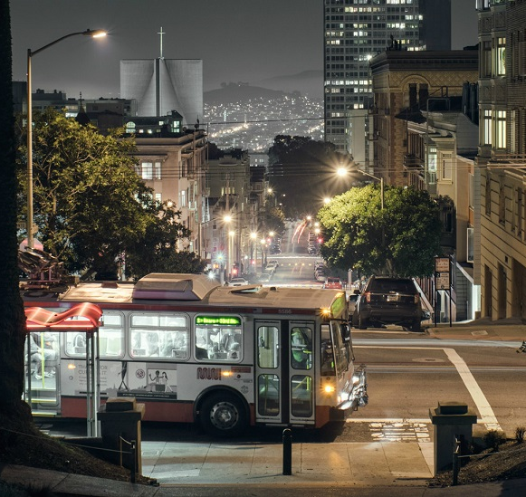
Muni Owl Service
Now starts at 10pm
30 min. headways
Owl Routes:
L Owl
N Owl
14 Mission
22 Fillmore
24 Divisadero
25 Treasure Island
38 Geary
44 O’Shaughnessy
90 San Bruno Owl
91 Owl
714 BART Early Bird

Slide 8
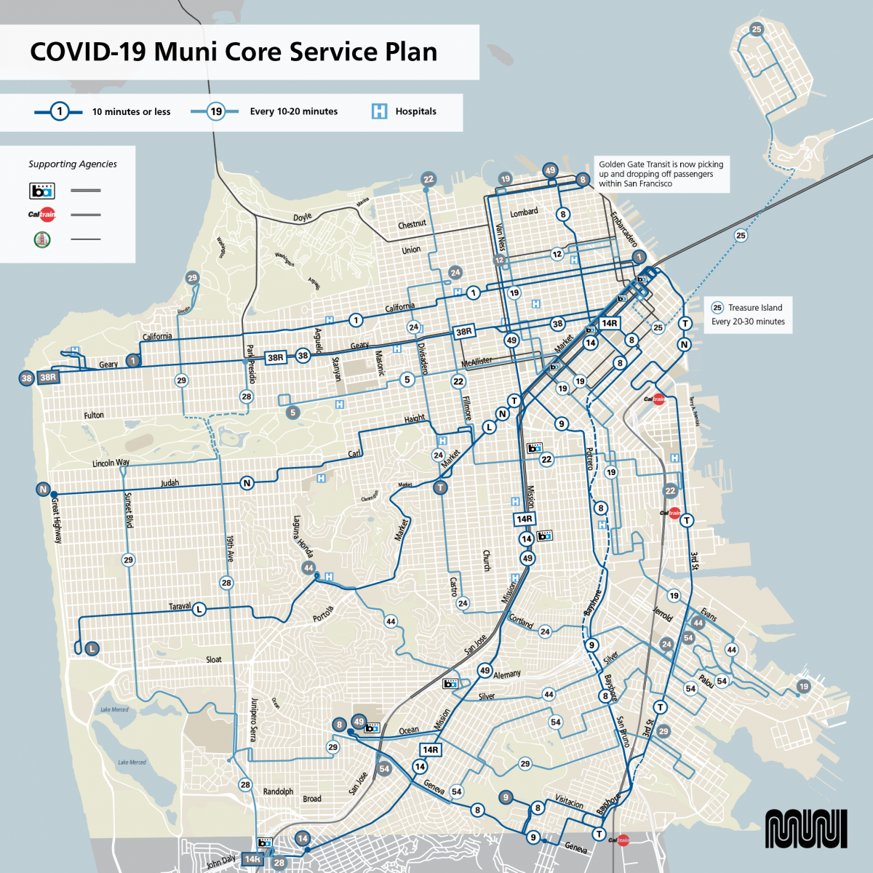

Slide 9
Essential Trip Card Program (ETC Program)
The program subsidizes taxi rides for essential trips like going to the grocery store, pharmacy or a necessary medical visit within San Francisco.

Slide 10
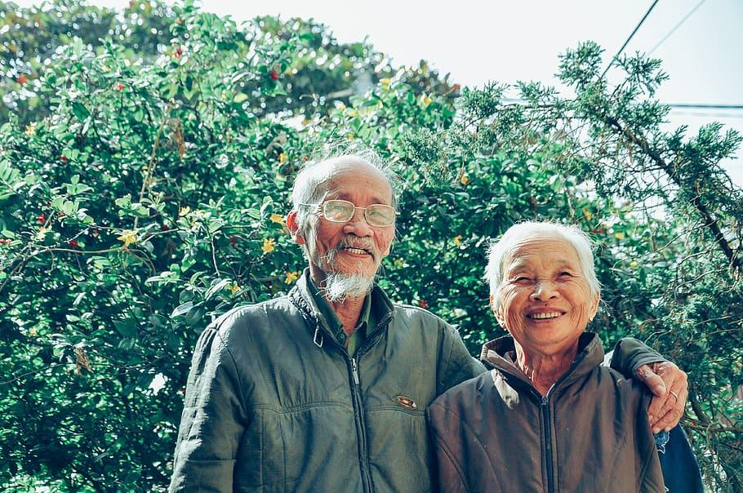
ETC Program Eligibility
To qualify for the program, customers must be a San Francisco resident who is 65+ or have a disability.

Slide 11
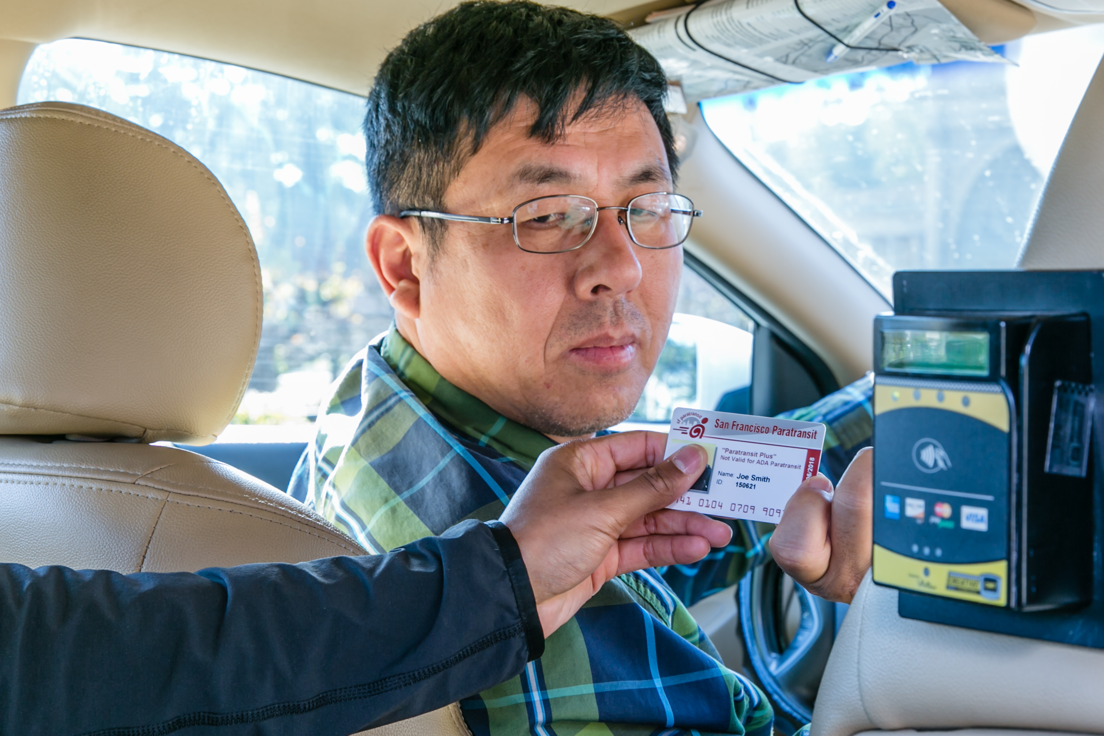
How does the ETC Program work?
For every $6 loaded on card, user receives $30 value, up to a monthly maximum value of $60 on card.

Slide 12
How to Apply for ETC Program
To make applying easy - Applicants call 311 and mention the ETC program.
Transferred to staff at Paratransit office
Open Monday through Friday 9:00am-4:45pm
More information, SFMTA.com/ETC

Slide 13
https://youtu.be/c7B2do_nigI

Slide 14
SF Paratransit Program
Door to door transportation for those ADA eligible - unable to use fixed-route transit independently
Three main modes
SF Access Van
Group Van
Taxi/Ramped Taxi

Slide 15
ADA Paratransit Certification
Limited to persons who are unable to independently use regular public transit (Muni) some or all of the time, due to a disability or health related condition.
Application
Application Review
Interview
Approval or Denial

Slide 16
How is the certification process different during COVID-19?
Submit application via email or by fax if possible.
Certification analysts are performing interviews by phone.
If eligible, temporary ID cards are being mailed without photos.

Slide 17
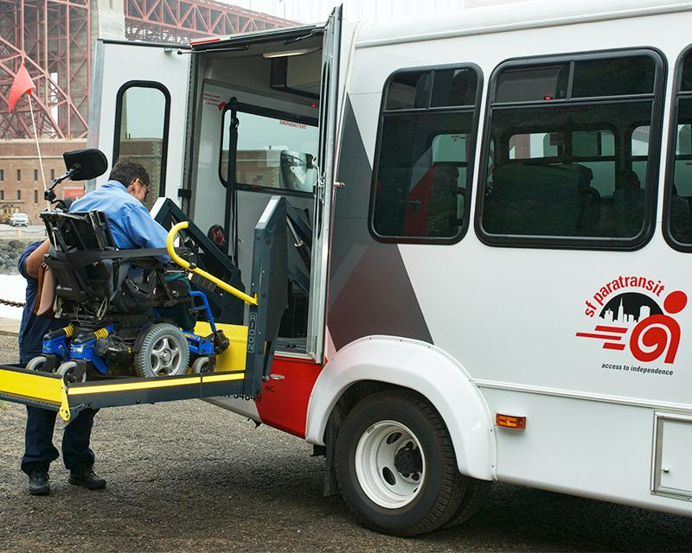
SF Access and COVID-19
Door to door, shared ride service
Pre-schedule 1 to 7 days in advance
¾ mile from all Muni bus routes including in Daly City
Encouraging customers to take essential trips only.
Safety Precautions:
Minimizing van capacity to maximum of 2 riders
SFMTA is providing masks to all drivers/staff
Vehicles cleaned frequently

Slide 18
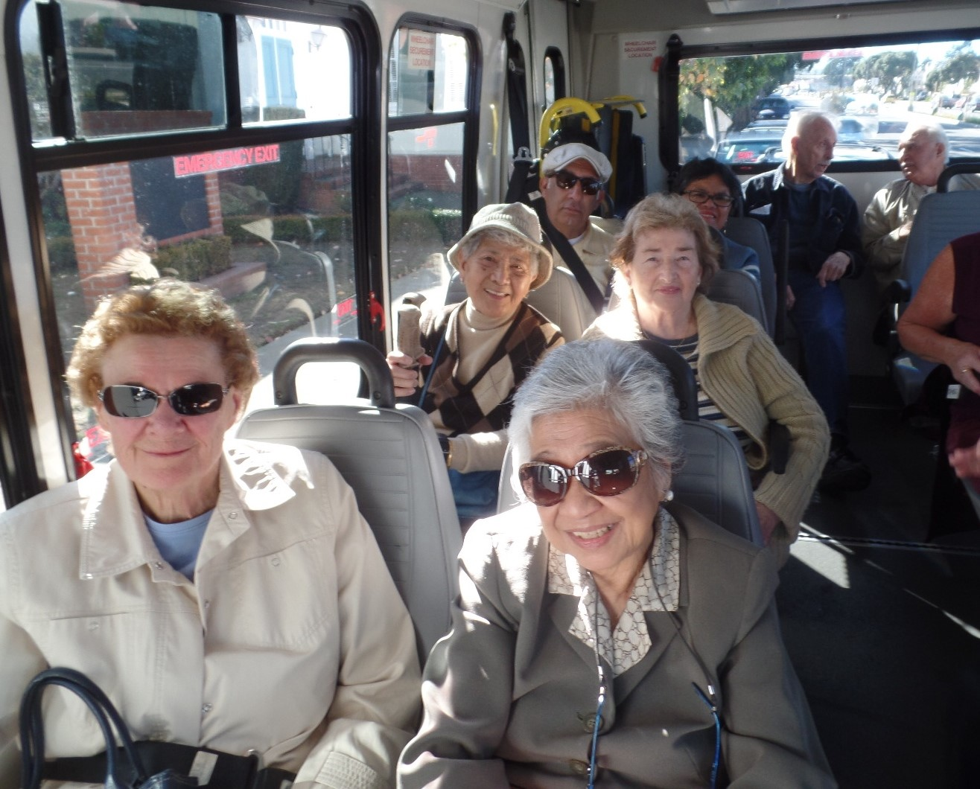
Group Van and COVID-19
Group transportation to/from single location, e.g. Adult Day Health Center
All trips are prescheduled in coordination with the agency
Since Shelter In Place order has been in effect, all sites have closed and no trips are being provided

Slide 19
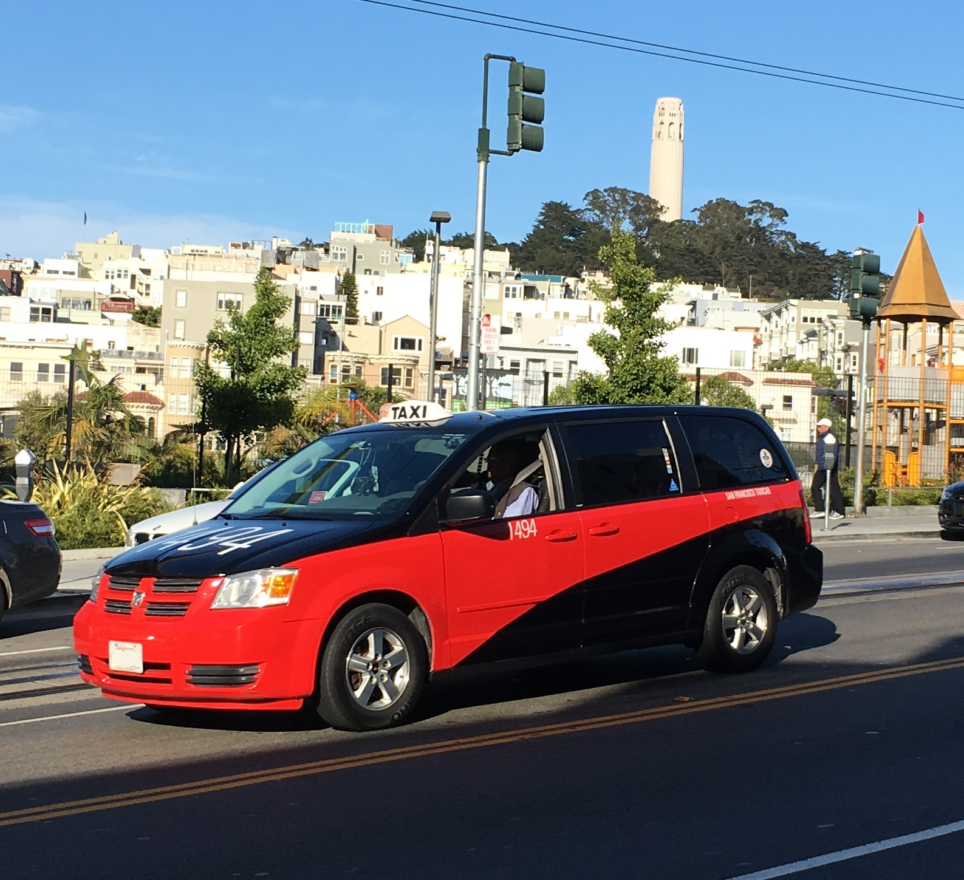
SF Taxis and COVID-19
Same day, on-demand service
All taxis are required to participate in SF Paratransit
Wheelchair accessible taxis are available
Encouraging customers to take essential trips only.
Safety Precautions:
Drivers have been issued PPE kits, are required to clean vehicle between trips, have been trained in proper cleaning protocols, and are required to wear face coverings

Slide 20
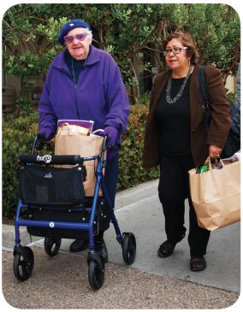
Shop-a-Round Program
Travel to grocery stores & farmers markets
Driver will assist passenger and grocery bags to front door
Following social distancing recommendations by limiting trips to max. 2 customers
Shop-a-Round Taxi available
Notes:
Allowing folks to ask for when they want to go during this time

Slide 21
Van Gogh Shuttle
Provides group transportation to seniors and people with disabilities to cultural and social events to reduce social isolation
Temporarily suspended during COVID-19

Slide 22
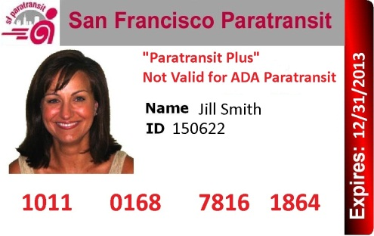
Paratransit Plus
Provides a limited value taxi debit card ($60 per month) to individuals who do not qualify for ADA paratransit but benefit from assistance for occasional trips

Slide 23
C.H.O.I.C.E Transportation Program
Pilot Program at Potrero Hill and Southeast Health Centers

Slide 24
SFMTA Mobility Management Center
One-stop information and referral center for older adults and people with disabilities:
Personalized transportation information and referral
Travel Training
SF Paratransit program information
Outreach to CBO’s

Slide 25
Visit the following for more information:
SFMTA COVID-19 Updates: SFMTA.com/COVID
Essential Trip Card Program- SFMTA.com/ETC
SF Paratransit- SFMTA.com/Paratransit
SF Paratransit Taxi- SFMTA.com/ParatransitTaxi
Shop-a-Round Program- SFMTA.com/ShopaRound

Slide 26
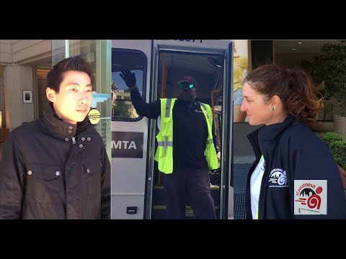
http://www.youtube.com/watch?v=BTjhwVQ0jxQ

