Slide 1
San Francisco Congestion Management Program
2019 Update
Citizens Advisory Committee Agenda Item 11
November 20, 2019

Slide 2
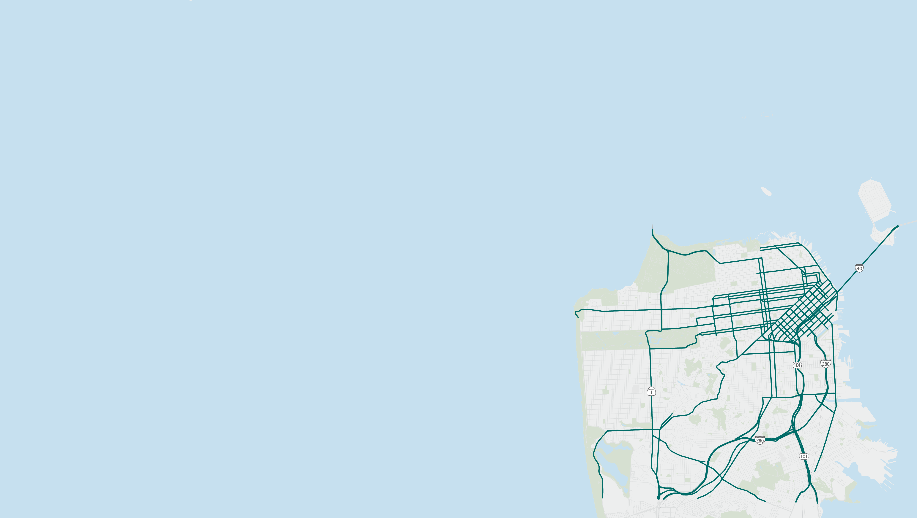
CMP Purpose and Requirements
Purpose
Define and report performance measures for congestion management
Describe congestion management strategies and efforts; 2019-21 work program
Requirements
Designated CMA updates every two years
Auto Level-of-Service (LOS) and multimodal performance measures
Travel Demand Management (TDM) and Land us impact analysis
Capital Improvement Program (CIP)
Approval of CMP
Maintains city’s eligibility for state gas tax and other revenues
CMP Monitoring Network 2019
Notes:
- As CMA, the Transportation Authority monitors and reports various performance measures on CMP network every two years.
CMP network includes over 230 miles of major arterials and freeways.
Requirements include monitoring Level-of-Service which is a measure of vehicle delay derived from auto speeds. However, we are unique in a way that we also measure several transit performance metrics in addition to automobile LOS.

Slide 3
Automobile LOS Monitoring - 2019
facility | period | 2017 | 2019 | Percent Change
Freeway | AM | 31.8 mph | 31.5 mph | -1%
Freeway | PM | 24.4 mph | 23.6 mph | -3%
Arterial | AM | 14 mph | 13.3 mph | -5%
Arterial | PM | 12.8 mph | 12.2 mph | -5%
Level of Service (LOS): Measure of auto congestion, required standard by law.
Average auto speeds decline further on CMP network
Notes:
As San Francisco continues to experience significant growth in jobs and population, auto speed decline further.
1-5% drop observed in auto speeds compared to last monitoring cycle.

Slide 4
Performance Metric Trends
Auto Speeds
Transit (Bus) Speeds
2019
DISCONNECT DUE TO DATA PRODUCT CHANGE FROM VENDOR
2019

Slide 5
Performance Metric Trends
Auto-Transit Speed Ratio
Transit Reliability / Variability

Slide 6
Key Updates in 2019 CMP
2019 system performance monitoring
Automobile Level-of-Service (LOS or delay) monitoring
Surface transit speed analysis
Updates on TDM studies and initiatives
Regional and State policy developments
Travel forecasting improvements
Capital Improvement Program (CIP): fund programming activities and project delivery progress
Interactive visualization website updates
Notes:
This CMP update also includes updates to TDM strategies, analysis of land use impacts on transportation, and the CIP chapter.
Interactive visualization updates. This significantly improves access to this data, and provides a means for the public to explore changes in transportation system performance over time
------------
-Consistent with SFTP
-TDM – SFTP recommendations, updates on Parking Pricing study, SFpark program, TI updates
-Land Use – reflects Plan Bay Area, Transportation Investment and Growth Strategy (TIGS), local efforts to link LU-T
-CIP consistent with latest TFCA programs, Lifeline Transportation Program, One Bay Area Grant, Prop AA Strategic Plan

Slide 7
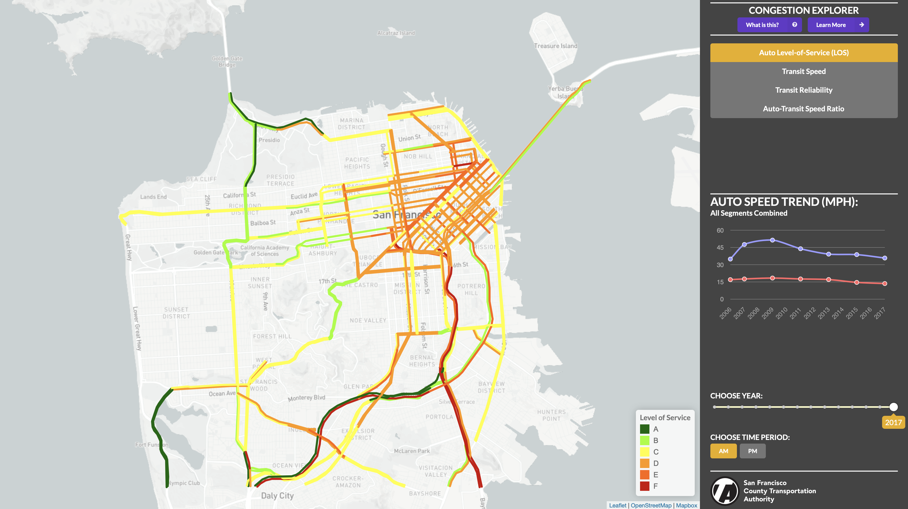
Congestion Data Visualization Website http://congestion.sfcta.org/

Slide 8
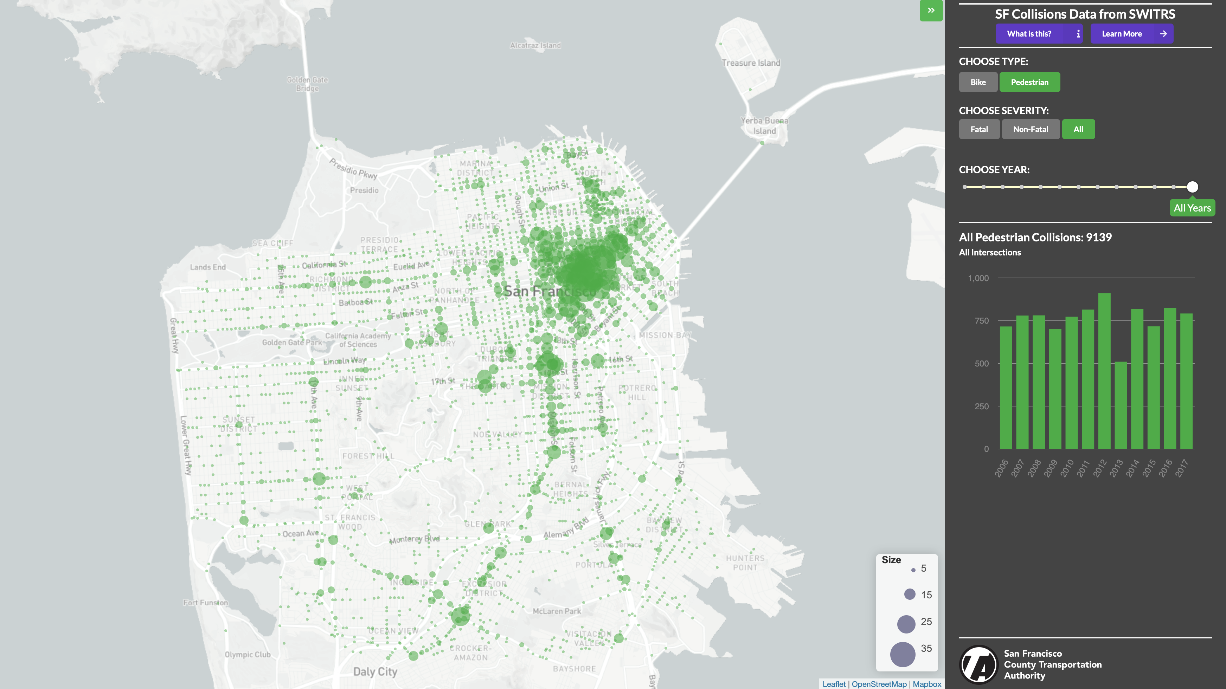
Collision Data Visualization Website under development

Slide 9
Thank you
Questions?

Slide 10
INRIX Data Changes
AVERAGE AUTO SPEED (MPH)
Segment geographies modified
Data provider mix updated
Data to be more accurate and reliable
Results in a disconnect in trend lines
DISCONNECT DUE TO DATA PRODUCT CHANGE FROM VENDOR
2019

Slide 11
Transit (Muni Bus) Speeds
AVERAGE SPEED (MPH)
 |  | 2017 | 2019 | % Change
Arterial | AM | 8.13 | 8.44 | 4%
Arterial | PM | 7.34 | 7.60 | 4%

Slide 12
Transit (Muni Bus) Variability
COEFFICIENT OF VARIATION
 |  | 2017 | 2019
Arterial | AM | 16% | 21%
Arterial | PM | 18% | 21%

Slide 13
Auto-Transit (Bus) Speed Ratio
AUTO-TRANSIT SPEED RATIO
 |  | 2017 | 2019
Arterial | AM | 1.67 | 1.58
Arterial | PM | 1.66 | 1.60
 |  | 2017 | 2019 | % Change
Arterial | AM | 1.67 | 1.58 | -5%
Arterial | PM | 1.66 | 1.60 | -3%

Slide 14
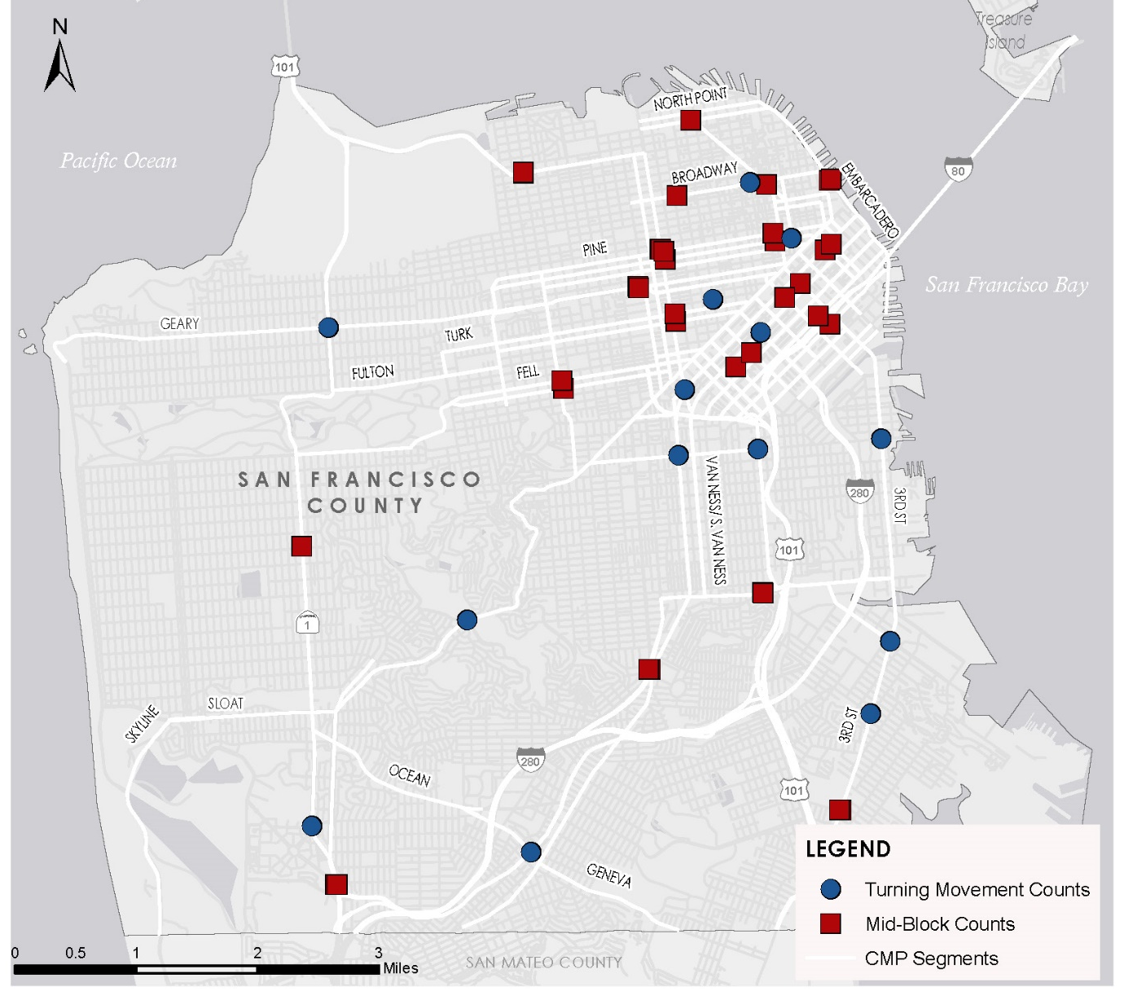
ADT and Multimodal Count Locations

Slide 15
Vehicle Counts
ADT COUNTS (37 LOCATIONS)
INTERSECTION COUNTS (14 LOCATIONS)
᾽17
᾽18
᾽19
᾽17
᾽18
᾽19
᾽17
᾽18
᾽19
᾽17
᾽18
᾽19

Slide 16
Bike-Ped Counts (14 Intersections)
᾽15
᾽17
᾽19
᾽15
᾽17
᾽19
᾽15
᾽17
᾽19
᾽15
᾽17
᾽19

Slide 17
Collisions
INJURIES
FATALITIES
*Provisional SWITRS data (not final)

Slide 18
VMT

Slide 19
Transit Ridership

