Slide 1
Federal Programming and the TIP
Karl Anderson
Metropolitan Transportation Commission
SPOC Workshop
Contra Costa County May 23, 2017
M e t r o p o l i t a n T r a n s p o r t a t i o n C o m m i s s i o n

Slide 2
What is the TIP?
Federal Programming and the TIP
4 Year Program of Projects
Clearinghouse of Project Information and Programming Data

Slide 3
Key Milestones that Require TIP Programming
Federal Programming and the TIP
Scheduling a Field Review
Final Caltrans Review of Environmental Documents
Obligation of Funding

Slide 4
Planning Context of the TIP
Federal Programming and the TIP
TIP projects must be consistent with the Regional Transportation Plan (RTP)
Description
Cost
Completion Year
TIP projects must be consistent with the Regional Transportation Air Quality Conformity Analysis for the RTP and the TIP
Description
Analysis Year

Slide 5
Grouped Listings
Multiple exempt projects included in one TIP listing

Slide 6
Grouped Listings – Caltrans Managed Programs
HBP, HSIP, SHOPP
In grouped listing for programming purposes
Individual listings for monitoring and project-level air quality purposes

Slide 7
TIP Revisions
Administrative Modifications
Relatively small funding changes and specific non-funding changes allowed per http://www.dot.ca.gov/hq/transprog/federal/fedfiles/ res_publications/rev_amend_proc.pdf
Final approval delegated to MTC
Shorter approval timeline

Slide 8
TIP Revisions
Amendments
Changes other than those allowed in administrative modifications per http://www.dot.ca.gov/hq/transprog/federal/fedfiles/res_publications/rev_amend_proc.pdf
Final approval by FHWA and FTA
Longer approval timeline

Slide 9
TIP Revisions
For Administrative modifications
For Amendments
1 Month
6 weeks
2 weeks
4 weeks
4 weeks
16 Weeks

Slide 10
Contacts
TIP and FMS
Adam Crenshaw Karl Anderson
(415) 778-6794 (415) 778-6645
acrenshaw@mtc.ca.gov kanderson@mtc.ca.gov

Slide 11
Using FMS
Karl Anderson
Metropolitan Transportation Commission
SPOC Workshop
Contra Costa County
May 23, 2017
M e t r o p o l i t a n T r a n s p o r t a t i o n C o m m i s s i o n

Slide 12
Using FMS - Overview
FMS User Accounts
TIP Revision Process
FMS Universal Application (UA)
Project Searches
Reports

Slide 13
FMS – User Accounts
Creating an Account
Links to Account Creation are on the FMS Home page (http://fms.mtc.ca.gov/fms/home.ds) and the Log In page
MTC Staff will Review the account, assign the appropriate privileges and restrictions, and activate the account
FMS Home Page
FMS Log In Page

Slide 14
FMS – User Accounts
Privileges and Restrictions
Public Users
Can search for projects and view project information
Local Road and Highway Sponsors
Access and edit their own projects through UA
CMAs
Access and edit projects for their own county through UA and submit revisions
Transit Operators
Access and edit their own projects through UA and submit revisions

Slide 15
TIP Revision Process – Lifecycle of a Project
New Project
Revised Project
Archived or Deleted Project

Slide 16
TIP Revision Process – Lifecycle of a Project Revision
New Project Revisions
New Projects
Universal Application >> Create New Project
Revisions to Existing Projects
Universal Application >> Create Revision
Revisions begin with an “In Process” status
They can be accessed through Universal Application >> Resume In Process Application

Slide 17
TIP Revision Process – Lifecycle of a Project Revision
Submitting a Revision
MTC Staff reviews Project Revisions
Decline – Project Revision is returned to the sponsor for edits
Accept – Project Revision moves on to the TIP Revision stage
Once accepted Project Revisions are bundled into a TIP Revision
The revision will be included in an Administrative Modification or a Formal Amendment
Given a TIP Revision Number (e.g. 2017-03)
Reviewed by MTC management and executive staff

Slide 18
TIP Revision Process – Lifecycle of a Project Revision
Accessibility of Project Revisions by Status
IN PROCESS
Viewable in Project Search
Accessible and editable in UA for users with the appropriate privileges
SUBMITTED and ACCEPTED
Viewable in Project Search but not UA
PROPOSED and ACTIVE
Viewable but not editable through Project Search and UA
Appropriate users may create new revisions using PROPOSED or ACTIVE versions as a base

Slide 19
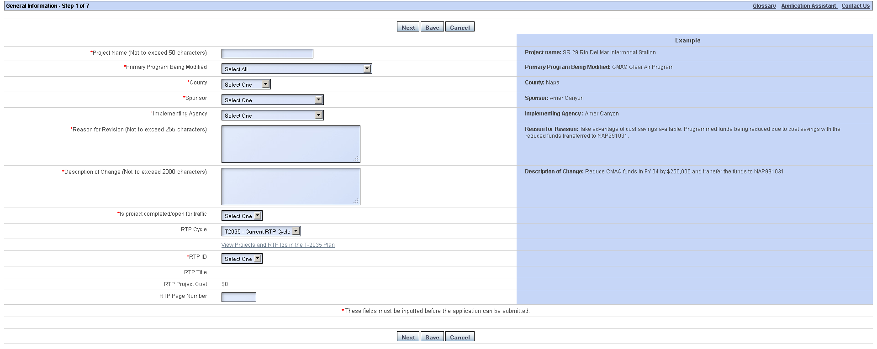
FMS – Universal Application
Project Detail Tab
Project Name
Primary Program
County
Sponsor
Implementing Agency
Reason for Revision
Description of Change
Project Complete Flag
RTP ID

Slide 20
FMS – Universal Application
Project Description Tab
Submode
Submode Percentage
Transportation System
Project Type
Purpose
Project Description
Expanded Description
Transportation Problem Addressed

Slide 21
FMS – Universal Application
Project Description Tab – Issues to be aware of
Sub-Mode
Enter sub-modes in descending order of priority
Purpose
Expansion – Project adds capacity to the existing system
Maintenance, Rehab, Replacement – Project preserves existing facilities
Operations – Project funds the administration and operations of agencies
System Management/Travel Demand Management – Project promotes more efficient use of existing facilities
Other – Option of last resort

Slide 22
FMS – Universal Application
Project Description Tab – Issues to be aware of
Project Description
Include the name of the jurisdiction
Include the project limits
Include the description of the work being done
Example – City: Street A from Road 1 to Road 2: Rehabilitate roadway, replace curbs and gutters, and patch sidewalks

Slide 23
FMS – Universal Application
Location Tab
Required Fields – State Assembly Districts, State Senate Districts, Congressional Districts
Optional Fields - Location, State Route, Post Miles, TIP Mapper Status Area

Slide 24
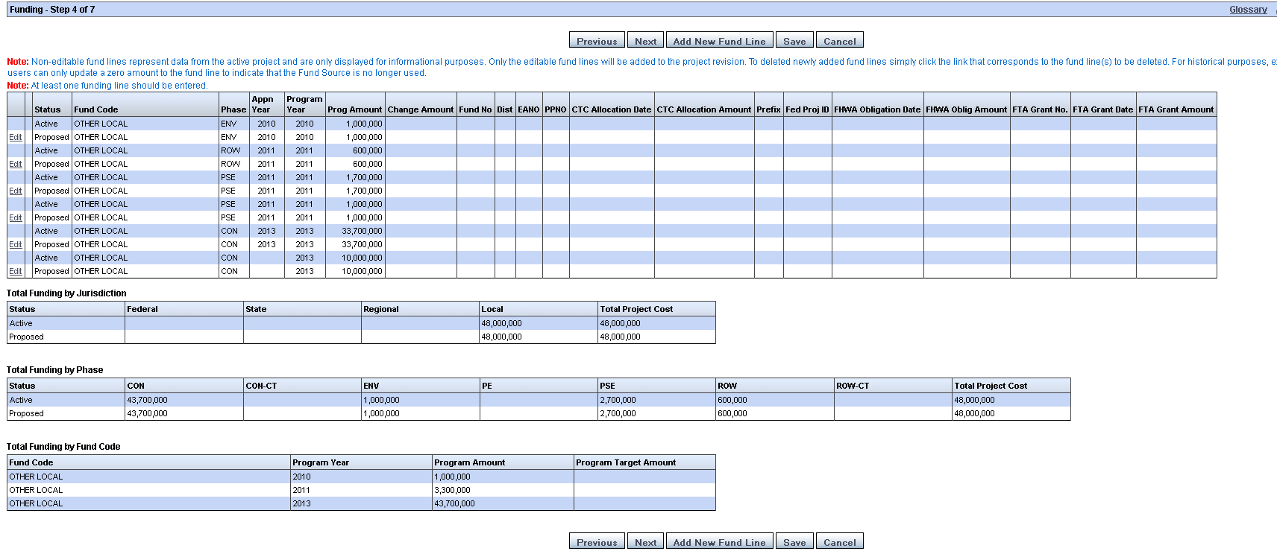
FMS – Universal Application
Funding Tab
Add a New Fund Line
Edit an Existing Fund Line
Remove funds from a project

Slide 25
FMS – Universal Application
Funding Tab – Add New Fund Line
Fund Code
Common issues finding fund codes
Regional Measure funds are under the “Bridge Tolls” source
Other State and Other Federal funds are options of last resort. If they must be used, include the full fund source in Reason for Revision and the Expanded Project Description

Slide 26
FMS – Universal Application
Funding Tab – Add New Fund Line
Phase
Most Common – PE, ROW, CON
Other Phases
PSE and ENV for STIP and ATP funded project only
ROW-SUP and CON-CE are Caltrans support for Right-of-Way and Construction phases

Slide 27
FMS – Universal Application
Funding Tab – Add New Fund Line
Apportionment Year
Program Year
Local match funds must be programmed in the same year and phase as the federal funds they are matching
Program Amount
Use positive whole dollar amounts only
Do not round to thousands or millions of dollars

Slide 28
FMS – Universal Application
Funding Tab – Editing Existing Fund Lines
Same functionality as adding new fund lines
Funding Tab – Removing funding from a project
The “Delete” link will only be displayed next to fund lines that you are allowed to delete
Once fund lines have been included in an approved revision you must zero out the fund line to remove the funds

Slide 29
FMS – Universal Application
Delivery Milestones Tab

Slide 30
FMS – Universal Application
Screening Criteria Tab

Slide 31
FMS – Universal Application
Contact Information Tab
Click the radio button next to the appropriate contact
Then click the Sponsor Agency, Implementing Agency, or MTC Contact button to assign the contact

Slide 32
FMS – Universal Application
Project Documents Tab
Do not use this tab for uploading Air Quality Conformity related documents
Do not create a new Revision only to upload a document – Contact MTC if only an upload is needed

Slide 33
FMS – Universal Application
Air Quality Tab
Regional Conformity – Only editable by MTC staff
Project Conformity – Needs to be completed by the Project Sponsor

Slide 34
FMS – Universal Application
Air Quality Tab – Edit Project Conformity
Answer Questions 1 – 6
Click the checkbox and save the entry
FMS or an MTC Air Quality Coordinator will notify users regarding any further actions that are needed

Slide 35
FMS – Universal Application
Review Tab
Side-by-side comparison of the current revision and the previous version – changes are shown in red
Fund lines from current revision are shown as Proposed and prior versions are shown as Active
Revisions may be saved or submitted based on privileges

Slide 36
FMS – Project Searches
Uses for Project Searches
View project information
Run Project Manager Reports
Project Listing Report – project information in the TIP as of the version selected
Project Authorization Report – more information than the Project Listing Report. This report should be submitted to Caltrans when requesting authorization to begin a phase
Project Detail Report – greatest amount of detail on a project
Edit Project Air Quality Conformity information without creating a revision

Slide 37
FMS – Contact Information
TIP and FMS:
Adam Crenshaw
(415) 778-6794
acrenshaw@mtc.ca.gov
Karl Anderson
(415) 778-6645
kanderson@mtc.ca.gov

Slide 38
Using FMS – Open Forum
Questions
Comments
Suggestions

