Slide 1
Overview of the Federal Aid Process for Transportation Projects

Slide 2
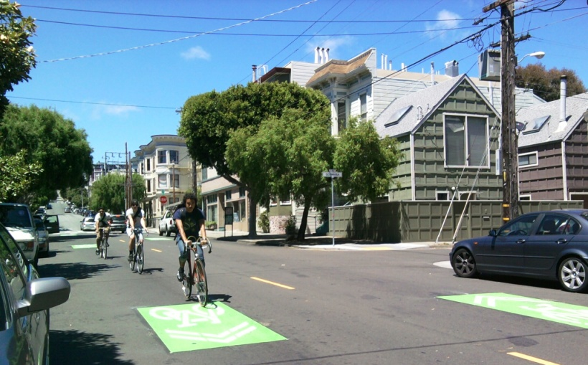
Where does the money come from?
Moving Ahead for Progress in the 21st Century (MAP 21)
Source of money–Highway Trust Fund & General Fund
States and local agencies generate and deliver projects within federal programs
Notes:
MAP-21- June 2012- replaced much-extended SAFETEA-LU.
2yrs
Highway Trust Fund
Gas tax funded- hasn’t increased since 1993.
Federal, state, regional, local responsibilities to program and deliver projects

Slide 3
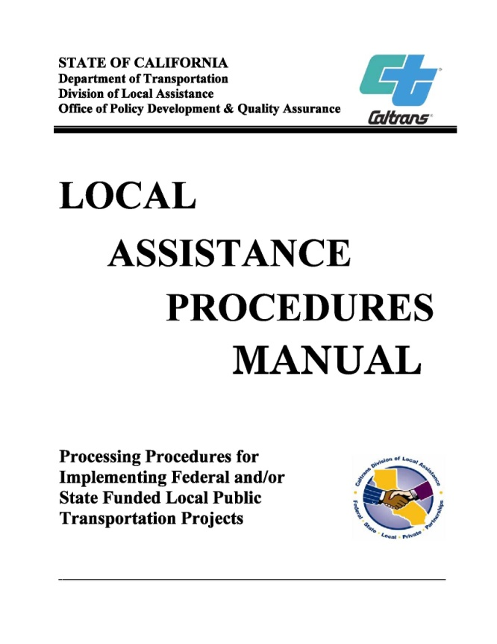
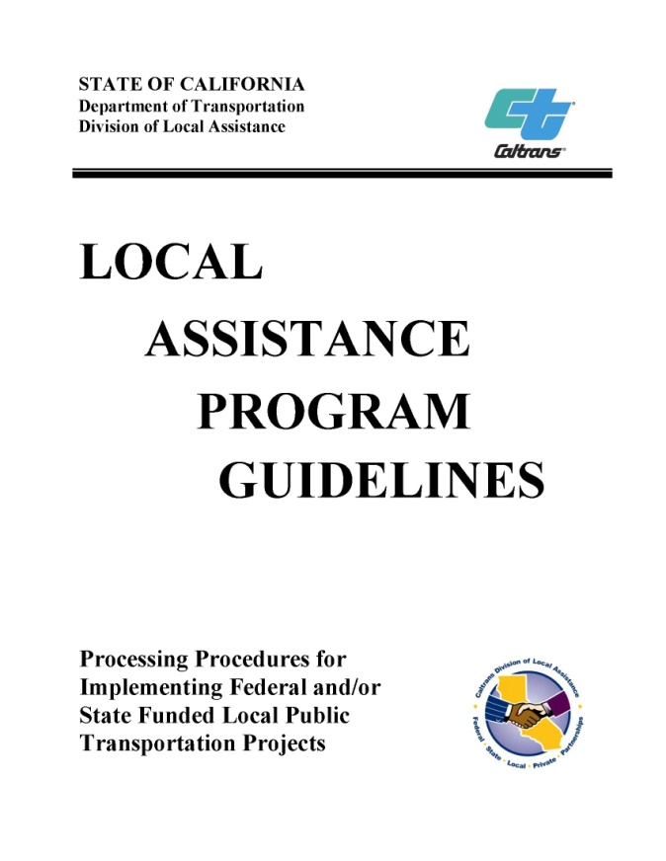
THE Guides
Need to check for updates!!
Get forms online
See Office Bulletins
Notes:
LAPM- is the step-by-step to the federal process. My slides correspond to chapters of the LAPM. It is over 1,000 pages. Best to focus on each section, as it is relevant to that project stage. It is where to start for answers to questions.
LAPG- focuses on different funding programs and includes eligibility guidelines, funding details, project selection, implementation, reporting, and timely use of funds information.
These are living documents. Sometimes changes to LAPM or LAPG are made via Office Bulletin and not made directly in the document for many months. Must check OBs regularly, too.

Slide 4
Chapter 2
Roles and Responsibilities
FHWA- General Oversight
Caltrans- Program Management and Project Oversight
MTC- Schedule projects and monitor progress
CTC-Program and allocate state funds
TA-Congestion Management Agency, County Transportation Plan
Local Agency- Project Implementation
Notes:
FHWA- role includes--approves/makes all Project agreements, Obligates funds.
(Obligation - The federal government’s legal commitment (promise) to pay or reimburse the
states or other entities for the federal share of a project’s eligible costs.)
Caltrans- establish policies and procedures for local agencies—w/ FHWA approval, program delivery and monitoring,
processing E-76’s, Field and enviro review (NEPA)
DBE and EEO compliance
MPO/RTPA- in this case MTC in Oakland
Schedules projects for the region
Monitors progress and deadlines
CTC- program and allocate state funds- for example, DPW’s current projects with TE funds- STIP is match, so need caltrans and CTC approval before expend.
Local-nominate projects, prepare documents (including NEPA technical studies, plans specs and estimates, ROW clearance, etc). and request authorization to spend funds (Obligation- is commitment to give you the money, authorization actually gives you the ability to spend and get reimbursed for a particular phase), expend funds according to regulations, and maintain the improvements.
Implications for agencies- getting approvals takes time- they often go to local assistance, then HQ in sacto, then up to FHWA for final signature.
Can be audited by Caltrans or FHWA. Also- Caltrans procedures are dictated by Fed- so can/do change based on Fed

Slide 5
THE Diagram
Local Oversight Agency Acceptance of Grant
Need Right of Way and Utility Certifications approved prior to submission of CON E76 request.
Notes:
If $1 on project- still need meet all requirements- particularly NEPA.
FSTIP-Federal Statewide Transportation Improvement Program
Note- reference chapters. Talk timelines! From MTC/Caltrans/Fed/CTC
“Authorize= E-76”
MTC role- and engaging them early and understanding how your project is scheduled in the TIP- keeping them abreast of any changes. They play key role in setting up timeline for moving through the steps in this chart.
Engaging Caltrans early- and paying attention to federal process early- even if no Fed money on PE phase, but will be later. Stress utility of Field Review.
Yellow box- before can expend any Federal funds- need to get Accept and Expend approval from your local oversight board- Board of Supervisors for Public Works.

Slide 6
Chapter 3
Project Authorization
BEFORE starting reimbursable work
For each phase: PE, ROW, CON
Notes:
Truth is- once there is an obligation for a project- you don’t just get a check and can spend freely. Is a promise, not a guarantee– if miss deadlines, fail to meet fed requirements, etc- could not get funds.
Authorization. (E-76)
Documents needed depends on phase- Field Review form, Environmental Documents, ROW Cert, PS&E package, Administration Cert.
CANNOT do work from next phase before E-76- manual gives detail on what, if anything can be done before next phase starts.

Slide 7
Chapter 4
Project Agreements
No Agreement= No Federal Reimbursement
Two agreements
Master Agreement
Program Supplement Agreement
Notes:
Agreements detail responsibilities and reimbursement process.
Master- one per agency-covers--Sets relationship between local agency and state. Timely use of funds, required retain records for 3 years after final voucher-- general conditions for all projects
PSA- one per project- location, work and cost details for project, federal aid proj. number
Finance letter will update funding for each phase.

Slide 8
Chapter 5
Accounting and Invoices
To invoice, need:
E-76 (PE, ROW, or CON) and Finance Letter
Master and Program Supplement agreements
Confirmation that activities and dates on invoice agree with E-76
Approved indirect cost plan (if asking for indirect cost reimbursement)
Failure to invoice=inactive project=de-obligation
Must include new Risk-Based Invoicing Checklist (Office Bulletin 14-05)
Notes:
E-76
for correct phase
Proves project has budget authority (TIP programming) and appropriation of funds, as well as other fed. documents submitted
Also gives reimbursement ratio of federal. Federal often 80-or 88%.
Indirect cost plans- need pre-approval by state auditor.
Invoice- frequency depends on amount in project- typically Caltrans requires invoices every 6 months. Final project cost-due 180 days after completion- w/ Final report. Costs limited by E-76.
Audit- Caltrans determines if needed.

Slide 9
Why emphasis on deadlines?
Use-it or lose-it (AB 1012)
Federal money- flows across borders and can flow back out of the state
Notes:
State has deadlines to ensure expenditure of available funds.
= deadlines around when must get E-76 by in the year funds programmed. Once have e-76, starts deadlines to invoice, advertise (if CON phase) - generally make progress.

Slide 10
Chapter 6
Environmental Procedures
NEPA v. CEQA
Preliminary Environmental Studies (PES) Form= 36 questions to help:
Examine project effect on environment
Determine which studies needed to evaluate impacts
Determines the probable level of NEPA document
Notes:
NEPA for any w/ $1 Fed. Different than CEQA
PES form- primary goal- help determine what need to study and probable level of NEPA Clearance-CE (categorical exclusion), EA (enviro assessment), or EIS
state-wide 95% local projects are CE- no impact, or little impact will be mitigated.
Questions cover topics from noise impacts during and after construction, to impact on biological resources, farmland, and cultural resources. Form is a series of yes- no – TBD questions, but requires additional info for each question. Answers will help determine what requires either more research or additional study.

Slide 11
Chapter 7
Project Field Review
Form is required for E-76
Actual field review usually optional, but recommended
Benefits- catch possible issues early
Get Caltrans input on questions
Notes:
Field Review form and process- goal is to gather initial project engineering info and related project data (like scope, functional classificaiton of road, cost by phase, schedule).
May be formal or informal- if off National Hwy System…if on- Caltrans decides review type.
It is intended to bring together all interested parties (like agency, DLA, and railroads, other utilities) and come to an agreement on the project requirements necessary to comply with federal and state laws and regulations.
If federally funding all phases- usually form is submitted before PE E-76. (Not how it looks on the chart)
When—for HBP- must be completed before any authorization.

Slide 12
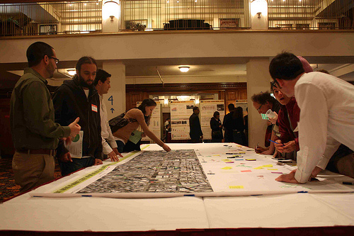
Chapter 8
Public Hearings
When a hearing is required
Potential controversy
Requested
Significant ROW
Structure of hearings- formal and informal
Notification requirements
Notes:
Can help get public input on alternatives, incorporate community needs into final design, etc.
Required
Environmental review level may dictate public hearing(s)
Requested- by public or another agency.
If holding a hearing- source for details on minutes requirements, location selection, etc.
Notification reqs- for example- published 2 times in papers circulated in area- in specified period.

Slide 13
Chapter 9
Disadvantaged Business Enterprise
DBE=small business majority owned/controlled by socially and economically disadvantaged individuals
Latest change- race neutrality and Caltrans review of DBE contract goals and good faith efforts (Office Bulletin 14-06)
Local agencies responsible for compliance
Notes:
Must meet requirements and get state certification as a DBE to count toward goals
Why keep changing their DBE calculation and approach---CA keeps failing to meet federal goals for state
Agency responsibilities
Establish and maintain a program
Set up a liaison who leads agency’s activities.
Enforce compliance- RE and liason
File utilization report

Slide 14
Chapter 10
Consultant Selection
Requires open competition and selection based on competence and professional qualifications
CANNOT consider cost when ranking
Notes:
Can negotiate AFTER ranking complete
Paperwork and process increases w/ size of contract.
CE cannot be done by design consultant
Review chapter to ensure your process is appropriate for the size/scope of your contracted work.

Slide 15
Chapter 11
Design Standards
Statewide standards
On v. Off the National Highway System
Exceptions
Notes:
These define statewide minimum standards. On Local roads- off the NHS, we can and do use local standards.
Defines process for what to do when an exception to standards is warranted- formal process required for work on bridges and highways- if for something like stopping sight distance or lane and shoulder width. Because NHS has been expanded, SF may need design exceptions to keep standards consistent throughout City. Need to document justification for exception on each project on NHS.
No exceptions for Manual of Uniform Traffic Control Device Standards

Slide 16
Chapter 12
Plans, Specifications, and Estimate (PS&E)
Helps ensure construction bids are competitive
Package includes:
Project plans and cost estimate
Special contract provisions
Federal documentation and requirements
Method of Construction
Notes:
PS&E- set of legal documents that become the heart of the contract that goes out to bid.
PS&E certification- local agency cert. Compliance w/ applicable fed/state/local laws re: design codes and standards, standard specs, estimate, Federal requirements pertaining to DBE, wage rates, etc.
includes Final design- CANNOT come before NEPA clearance
Includes engineers estimate- quantifies contract items for bidding purposes.
3 construction methods
Contract- goes to lowest bidder who is responsive and responsible
Force Account (must justify- why in public interest (cheaper) way to go, or why City is only entity capable to perform work)
Emergency Work (no detailed PS&E required)

Slide 17
Chapter 13 &14
Right of Way and Utilities
ROW E-76- need for acquisition
ROW E-76- may need for utility relocation
Notes:
You need to program money for a distinct ROW phase if acquiring R/W. This chapter gives extensive detail on the actual acquisition process and related forms.
Preliminary ROW work can happen under PE- but only limited activities- planning studies and prelim appraisal
Actual appraisal and acquisition must be post ROW authorization. Must have appraisal complete before make any offer for purchase.
ROW Cert form will be needed for all projects- short form in NO ROW required (okay if there is MINOR utility work- raising manhole covers only. ) Otherwise- long form. Nearly all projects require long form.
Utilities- Chapter 14 is only for local projects. Caltrans ROW manual applies for state highway projects.
ID utility conflicts early- good to invite utility staff from Caltrans to Field review if anticipate.
Chapter outlines utility procedures from mapping to notifying owners and relocating.

Slide 18
Almost there.
Tired yet?
Questions so far?
Ready to Advertise?

Slide 19
Chapter 15
Advertisement and Award
Before can advertise need Caltrans approved:
Construction administration procedures
NEPA approval and ROW Cert
Certified PS&E package
FHWA Authorized E-76
Bid Opening
Award Package
Office Bulletin 14-08, NTP letter must go to Caltrans when it is sent to Contractor.
Notes:
Construct admin- for non NHS- just need checklist complete for E-76, if NHS- actual procedures need approval
E-76 must have final signature in FMIS. This will be last signature on E-76 form- confirm the document you have has one.
May not get PSA now, if got one for PE phase. Will get a revised, approved finance letter.
Bid opening
Goes to lowest bidder who is
“response”-meets all advertisement requirements
“responsible”-physically organized and financially capable to complete the contract
Award- ensure sufficient funds for lowest bidder. Submit award package to Caltrans promptly. Award package should go to Caltrans with first invoice for CON.
Chapter covers details of what goes in the award package, too.

Slide 20
Chapter 16
Construction Administration
Construction Engineering up to 15%
Pre-construction conference
Document, document, document
Project files
Accounting
Daily reports
Change orders and contractor claims processing
Notes:
CE- can get CE over 15% authorized by DLA- would need approval and enough funds to cover.
Otherwise- have to overmatch project- use excess local funds to cover CE overages.
Pre-CON conference- chance to enhance communication w/ contractor, review schedule, EEO & DBE
Documentation-
Keep separate files for each Federal Project- if multiple federal funding on one project- need to keep distinct track of costs.
Resident Engineer to keep a daily journal.
Details for contents of all outlined in LAPM
Must retain Paper files! These will be needed, in case of an audit.
All files must be retained for 3 years after “final voucher”- which usually takes 6 months after city accepts project and submits final invoice.

Slide 21
Chapter 17
Project Completion
Completion=all paperwork approved by DLAE and FHWA issues final voucher
Chapters 18-20
Maintenance, Process Review, Deficiencies and Sanctions
Notes:
Final agency paperwork- includes final expenditure report to doc. Completion of CON, enviro mitigation measures, and acceptance of project by local agency. Forms include final detail estimate, DBE report, materials cert., etc.
Chapter 18- Maintenance Requirement, Chapter 19, Process Review, Chapter 20- Deficiencies and Sanctions
Caltrans is responsible for ensuring maintenance of all bridges on federal-aid routes, and all projects done w/ fed aid dollars. If fail to maintain, could actually end up having to pay back fed.
Process Review- like an audit but for a specific process/ procedure that Caltrans is focusing on evaluating. –can be formal or not.
Result is report of their findings having looked at a topic across projects and agencies.
Sanctions- some fatal flaws=return federal funds
Examples- proceed to phase pre-E-76
Project not really in FSTIP or doesn’t match
Proceed to final design pre NEPA approval
Doesn’t meet enviro mitigations
Consultant contract doesn’t have required federal provisions
Award improperly- not lowest, negotiate pre-award
Fail to enforce DBE with regard to utilization, subsitution or good-faith determination.

Slide 22
A few takeaways
Check online for latest manual & forms
Engage Caltrans early and often
Document and retain
Authorize before you advertise
Know what your signing or ask
Despite all of the rules- some things still subjective
Notes:
Documents- paper forms…save 3 years after final voucher.
These are legal commitments by agency. Fed can take money back for failure to comply.
Because some things aren’t set in the LAPM or LAPG, communication with Caltrans is key. For example, what constitutes a utility has proven to cause some confusion—and often requires CT confirmation (in writing).

